Slide 1
Lectures at the Uni Luxembourg Introduction to Graph Neural Networks
Christian Medeiros Adriano (christian.adriano@hpi.de)
“Chris”

Slide 2
Quick recap – Where are we now?
Intro and Course Organization
Graph Metrics and Random Models
Graph Structural Features – Clustering
Message Passing & Belief Propagation
Graph Embeddings - Message Passing
PageRank & Markov Chains
Graph Convolutional Networks
Graph Attention Networks
Graph Evolution Networks
Temporal Graph Networks
Graph Neural Differential Equations
Deep Graph Generative Models
Causal Graph Neural Networks
Propagation Graph Neural Networks
Outbreaks, Cascading and Contagion
Optimization on Graphs and Submodularity
Design concerns
Understand a phenomenon
Extract features
Stablish baselines
Preprocessing data
Description models
Predict an outcome
ML architecture and pipeline
Training models
Evaluation models
Prediction models
Effects of interventions
Risks of confounding
Causal structure
Intervention models

Slide 3
Session-1 Basics Concepts and Motivation

Slide 4
Types of graphs
Directed
Undirected
Disconnected
Fully connected
A
A
A
A
B
B
B
B
C
C
C
C
D
D
D
D
Directed Acyclic Graph
Multigraph
Bipartite
Cliques
E
A
A
A
A
B
B
B
F
B
C
C
C
D
D
D
C
D
Ego network of A

Slide 5
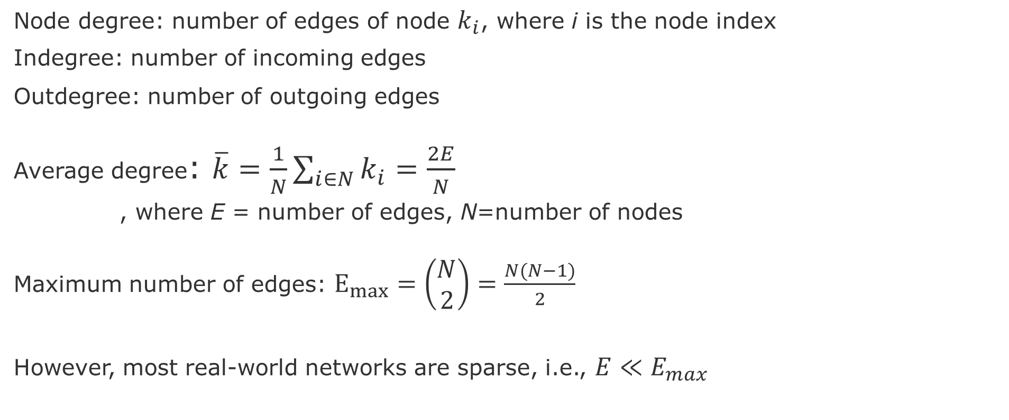
Node and Edge degrees
Node degree: number of edges of node $k_{i}$, where i is the node index
Indegree: number of incoming edges
Outdegree: number of outgoing edges
Average degree: $\overline{k}=\frac{1}{N}\sum_{i∈N}{k_{i}}=\frac{2E}{N}$
, where E = number of edges, N=number of nodes
Maximum number of edges: $E_{max}=\left(\begin{aligned}N \\ 2\end{aligned}\right)=\frac{N(N−1)}{2}$
However, most real-world networks are sparse, i.e., $E≪E_{max}$
Notes:
Leskovec, Jure, et al. "Community structure in large networks: Natural cluster sizes and the absence of large well-defined clusters." Internet Mathematics 6.1 (2009): 29-123.

Slide 6
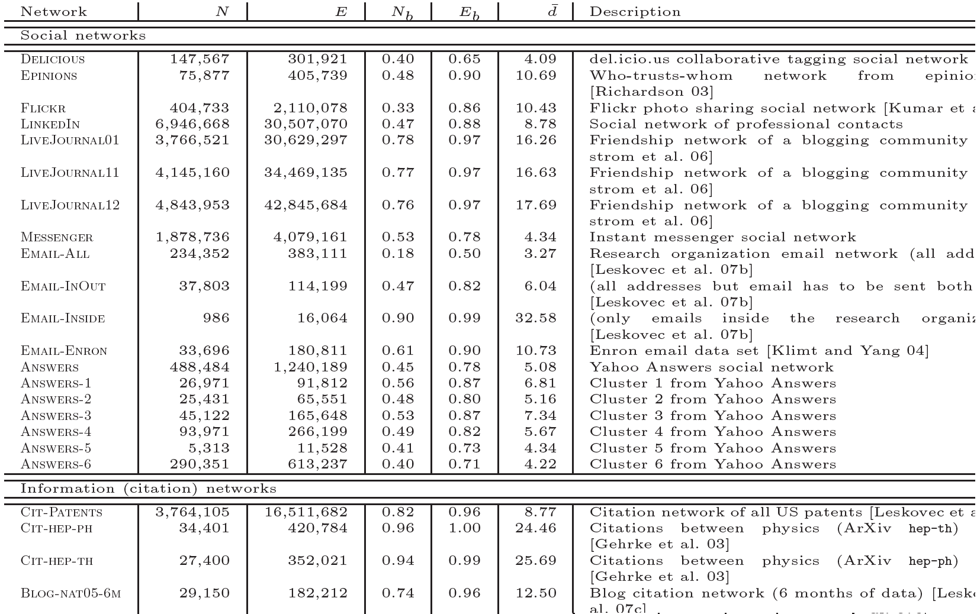
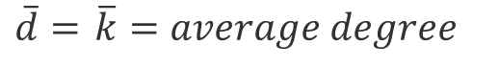
Most real-world networks are sparse
$\overline{d}=$ $\overline{k}=average degree$
source :Leskovec, J., et al. "Community structure in large networks: Natural cluster sizes and the absence of large well-defined clusters." Internet Mathematics 6.1 (2009): 29-123.

Slide 7
Adjacency matrix
 | A | C | D | B | E | F
A | 1 | 1 | 1 | 1 | 0 | 0
C | 1 | 0 | 1 | 1 | 0 | 0
D | 1 | 1 | 0 | 1 | 0 | 0
B | 1 | 1 | 1 | 0 | 1 | 1
E | 0 | 0 | 0 | 1 | 0 | 1
F | 0 | 0 | 0 | 1 | 1 | 0
Cliques
E
A
F
B
C
D
However, adjacency matrix of real-world networks are full of zeros

Slide 8
Motivation for Learning on Graphs and GNNs

Slide 9
Scenarios and Network Types
Network Types
Event graphs
Disease pathways
Knowledge-graphs
Scene graphs
Heterogeneous graphs (different types of nodes and edges)
Scenarios
Clustering in Social network
Protein interaction
Cell similarity networks
Failure propagation in infrastructure networks
Fake news detection
Side-effects of drugs
Network attacks
Traffic jams

Slide 10
Types of Predictions
Node classification
What type of node is this?
Link prediction
Are these two nodes connected?
With which strength?
Graph Classification
Patterns of connectivity (motifs)
Network similarity (isomorphism)
Notes:
Leskovec, Jure, et al. "Community structure in large networks: Natural cluster sizes and the absence of large well-defined clusters." Internet Mathematics 6.1 (2009): 29-123.

Slide 11
Next steps
Lecture-2: Overview of Graph Theory and Network Science (Wed 13h30 - 15h00)
Degree Distribution
Path length
Clustering Coefficient
Null-Models for Graphs
First task:
Accept Slack invitation
Study datasets
See examples of use of Snap or NetworkX
Think of scenarios

Slide 12
Node Degree Distribution $P\left(k\right)=N_{k}/N$
A
2
B
4
C
D
3
2
 | A | C | D | B | E | F | ∑
A | 1 | 1 | 1 | 1 | 0 | 0 | 4
C | 1 | 0 | 1 | 1 | 0 | 0 | 3
D | 1 | 1 | 0 | 1 | 0 | 0 | 3
B | 1 | 1 | 1 | 0 | 1 | 1 | 5
E | 0 | 0 | 0 | 1 | 0 | 1 | 2
F | 0 | 0 | 0 | 1 | 1 | 0 | 2
E
A
F
B
C
D

Slide 13
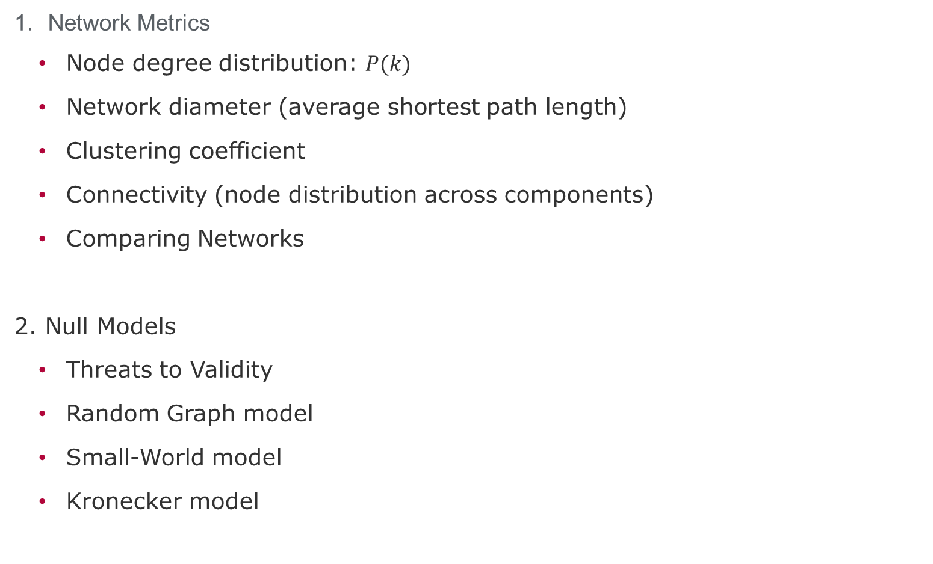
Session topics
Network Metrics
Node degree distribution: $P(k)$
Network diameter (average shortest path length)
Clustering coefficient
Connectivity (node distribution across components)
Comparing Networks
2. Null Models
Threats to Validity
Random Graph model
Small-World model
Kronecker model

Slide 14
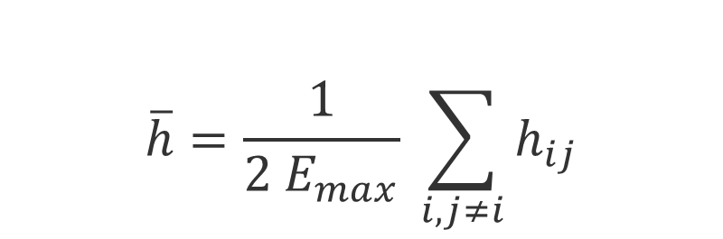
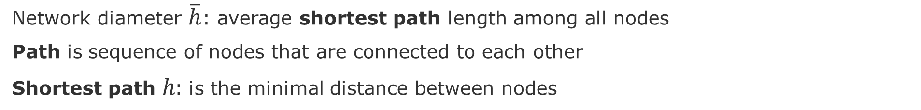
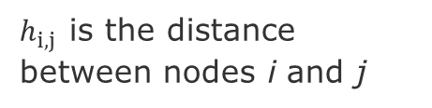
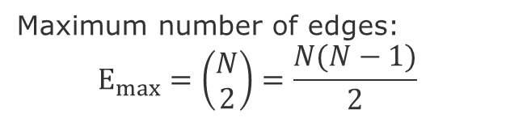
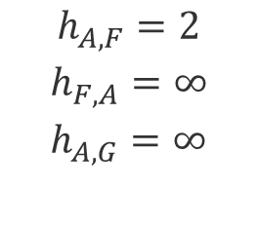
Network Diameter (or geodesic distance)
Network diameter $\overline{h}$: average shortest path length among all nodes
Path is sequence of nodes that are connected to each other
Shortest path $h:$ is the minimal distance between nodes
E
$$\overline{h}=\frac{1}{2 E_{max}} \sum_{i,j≠i}{h_{ij}}$$
A
F
B
H
C
G
D
Maximum number of edges:
$$E_{max}=\left(\begin{aligned}N \\ 2\end{aligned}\right)=\frac{N(N−1)}{2}$$
$$h_{A,F}=2$$
$$h_{F,A}=∞$$
$$h_{A,G}=∞$$
$h_{i,j }$is the distance between nodes i and j

Slide 15
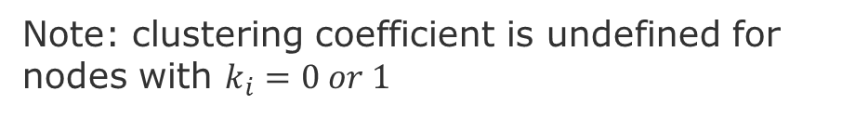
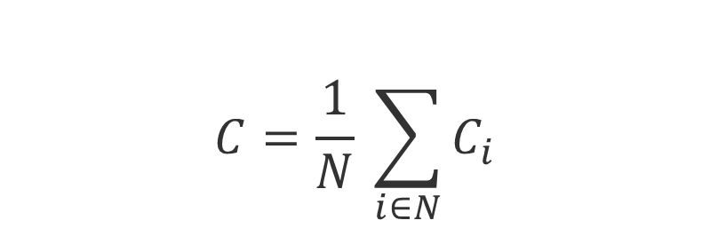

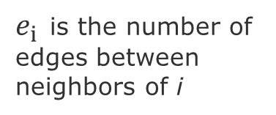
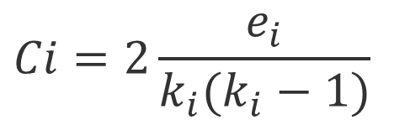
Clustering coefficient $C_{i}$
$C_{i}$Measures how many of my neighbors are connected to each other
$$C_{i}∈\left[0,1\right]$$
$$Ci=2\frac{e_{i}}{k_{i}(k_{i}−1)}$$
A
A
A
A
$e_{i }$is the number of edges between neighbors of i
B
B
B
B
C
C
C
C
D
D
D
D
$$C_{A}$$
0.0
0.3
=2*1/3*2
0.67
=2*2/3*2
1.0
=2*3/3*2
total possible edges
Note: clustering coefficient is undefined for nodes with $k_{i}=0 or 1$
Average Clustering Coefficient
$$C=\frac{1}{N} \sum_{i∈N}{C_{i}}$$
Notes:
Clustering coefficient is undefined for nodes with ki = 0 or 1

Slide 16
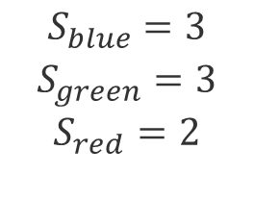
Connectivity $S$
Connectivity $S$: is the largest set of nodes that can be connected through any given path
E
A
F
B
H
C
G
D
$$S_{blue}=3$$
$$S_{green}=3$$
$$S_{red}=2$$

Slide 17
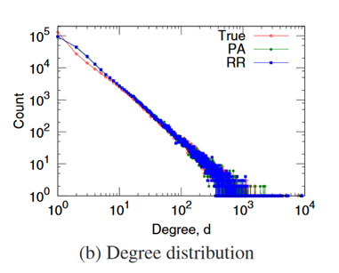
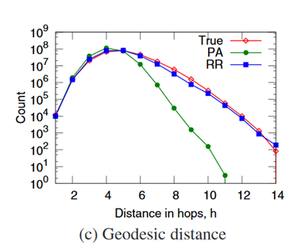
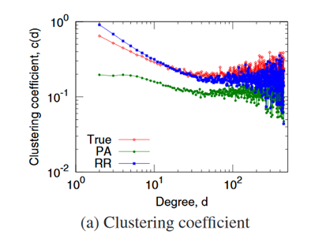
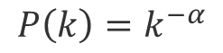
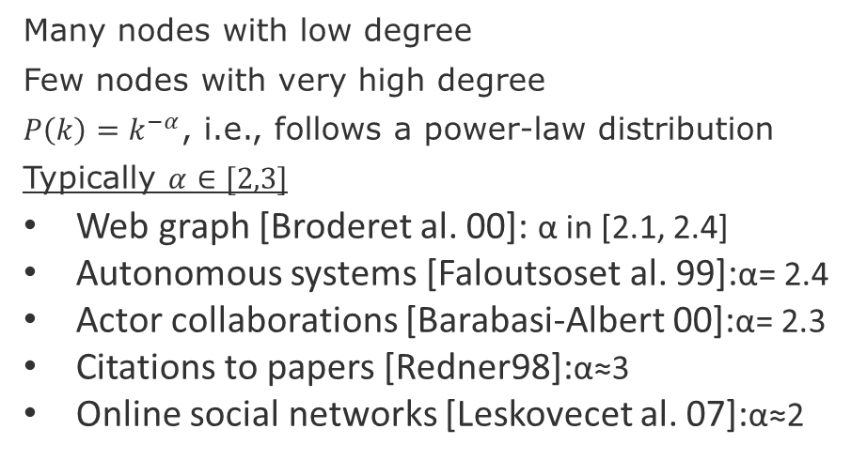
Empirical values (Flickr)
$$P\left(k\right)=k^{−α}$$
Many nodes with low degree
Few nodes with very high degree
$P\left(k\right)=k^{−α}$, i.e., follows a power-law distribution
Typically $α∈[2,3]$
Web graph [Broderet al. 00]: α in [2.1, 2.4]
Autonomous systems [Faloutsoset al. 99]:α= 2.4
Actor collaborations [Barabasi-Albert 00]:α= 2.3
Citations to papers [Redner98]:α≈3
Online social networks [Leskovecet al. 07]:α≈2
Few hops on average allow to reach anywhere in the network
Low degree nodes tend to have higher clustering
Note: remember to plot degree distributions and clustering coefficients in log-log scale
Source: Leskovec, Jure, et al. "Microscopic evolution of social networks." Proceedings of the 14th ACM SIGKDD 2008.

Slide 18
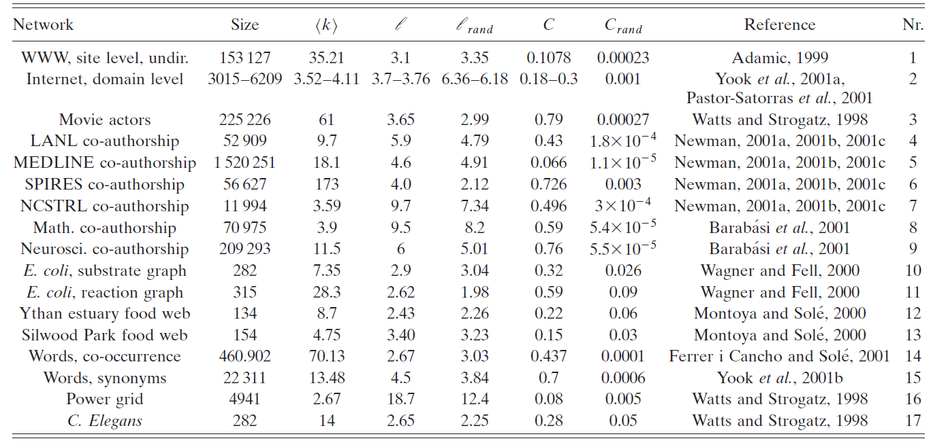
Comparing some networks
Average Clustering coefficient
Average degree
Network diameter
Source:
Albert, R., & Barabási, A. L. (2002). Statistical mechanics of complex networks. Reviews of modern physics, 74(1), 47.

Slide 19
Other ways of comparing networks
Known Node Correspondence Methods:
Difference of the adjacency matrices
DeltaCon (similarity between node pairs)
Cut distance
Unknown Node Correspondence Methods:
global statistics,
matching of subgraphs (graphlets)
Relative Graphlets Frequency Distance (RGFD)
Graphlet Degree Distribution Agreement (GDDA)
alignment-based methods entropy measures (isomorphism)
spectral methods (distance-based)
Source: Tantardini, M., Ieva, F., Tajoli, L., & Piccardi, C. (2019). Comparing methods for comparing networks. Scientific reports, 9(1), 1-19.

Slide 20
The Null Models

Slide 21
Motivation
We need null-models to compare our graph metrics in a principle and reproducible manner
Obtain a real network
Generate a synthetic network
Compare networks
Null-models are generate by synthetic graph generation procedures.
Random Graph Model
Small-World Model
Kronecker Graph Model

Slide 22
Threats to validity
Construct validity: measurements might not be correct
Conclusion validity: instruments or methods adopted are not adequate
Internal validity: relations of cause-effect might not be true
External validity: results do not generalize to slight changes in the data or context.
Recommended readings:
Siegmund, J., Siegmund, N., & Apel, S. (2015, May). Views on internal and external validity in empirical software engineering. In Proceedings of the 37th International Conference on Software Engineering-Volume 1 (pp. 9-19). IEEE Press.
Wieringa, R. J. (2014). Design science methodology for information systems and software engineering. Springer.
Wohlin, C., Runeson, P., Höst, M., Ohlsson, M. C., Regnell, B., & Wesslén, A. (2012). Experimentation in software engineering. Springer Science & Business Media.

Slide 23
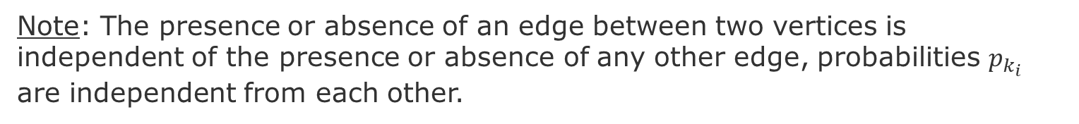
Random Graph - Erdös-Rényi (ER) networks
Stochastically connect nodes
E
E
E
A
A
A
F
F
F
B
H
B
H
B
H
C
G
C
G
C
D
D
G
D
Procedure:
For each pair of nodes decide do connect them with a probability $p_{k}$
Note: The presence or absence of an edge between two vertices is independent of the presence or absence of any other edge, probabilities $p_{k_{i}}$ are independent from each other.
Source: Newman, Mark EJ, Steven H. Strogatz, and Duncan J. Watts. "Random graphs with arbitrary degree distributions and their applications." Physical review E 64.2 (2001): 026118.

Slide 24
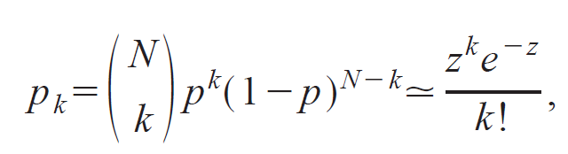
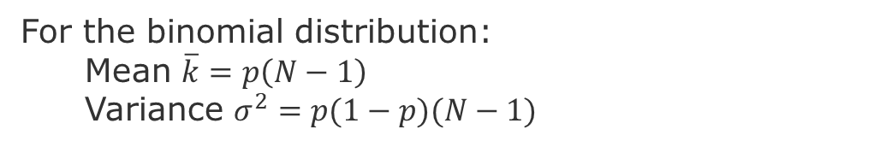
Random Graph – Distribution of Node Degree
Distribution of Node Degrees
z = average number of edges
k = degree of an edge
In the limit when N is very large. i.e., a Poisson distribution
For the binomial distribution:
Mean $\overline{k}=p\left(N−1\right)$
Variance $σ^{2}=p(1−p)(N−1)$
Newman, Mark EJ, Steven H. Strogatz, and Duncan J. Watts. "Random graphs with arbitrary degree distributions and their applications." Physical review E 64.2 (2001): 026118.
Notes:
Poisson Distribution = probability of a given number of events occurring in a fixed interval of time or space if these events occur with a known constant mean rate and independently of the time since the last event

Slide 25
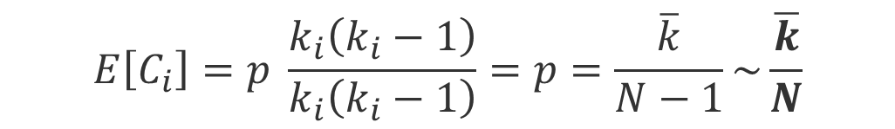

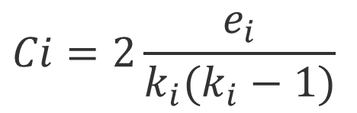
Random Graph – Clustering coefficient
Clustering coefficient:
$$Ci=2\frac{e_{i}}{k_{i}(k_{i}−1)}$$
$$E\left[e\right]=p \frac{k_{i}(k_{i}−1)}{2}$$
$$E\left[C_{i}\right]=p \frac{k_{i}\left(k_{i}−1\right)}{k_{i}\left(k_{i}−1\right)}=p=\frac{\overline{k}}{N−1}\sim \frac{\overline{k}}{N}$$
This means that the clustering coefficient of a random graph is small. As we generate bigger random graphs with a fixed average degree k, i.e., we set 𝑝=𝑘⋅1/N), C will decrease with the graph size N
Notes:
To derive this formula see

Slide 26
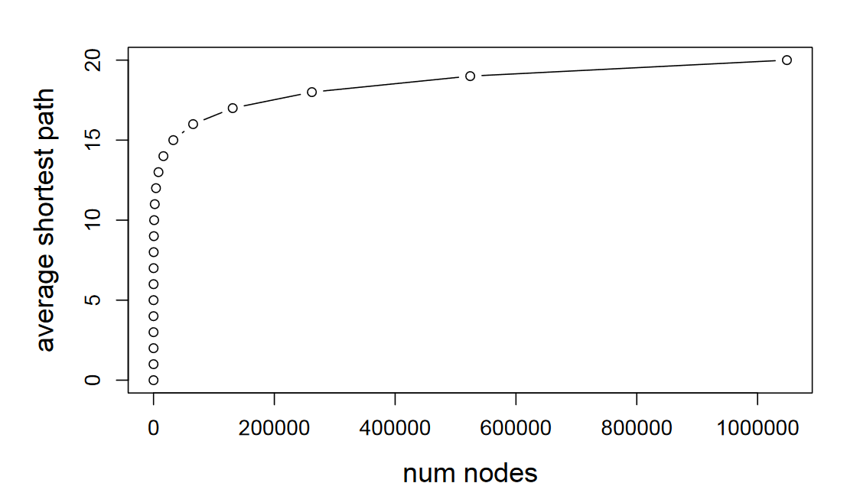
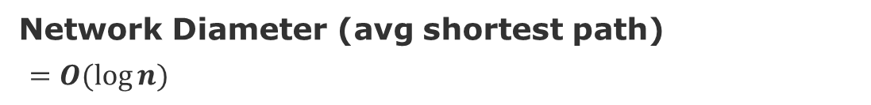
Random Graph – Network Diameter
Network Diameter (avg shortest path)
$=O(log⁡n)$
[Leskovec 2019]
Average degree constant
Notes:
[Leskovec 2019] http://web.stanford.edu/class/cs224w/slides/02-gnp-smallworld.pdf

Slide 27
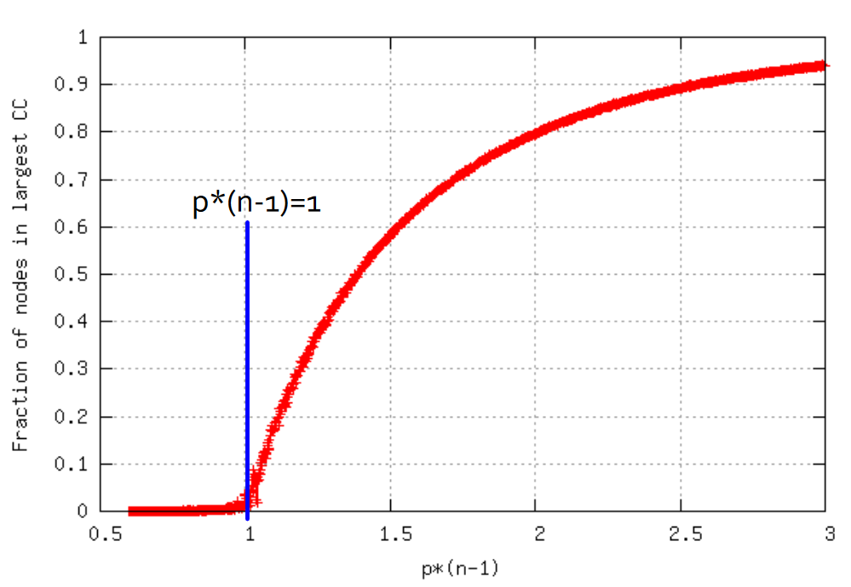
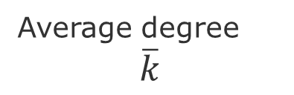
Random Graph – Connectivity
Tend to have giant components
Everything gets connected.
Disconnected graph
Fully connected graph
Average degree
$$\overline{k}$$

Slide 28
Again - Comparing some networks
Average Clustering coefficient
Average degree
Network diameter
Actors
Power grid
C. elegans
Source:
Albert, R., & Barabási, A. L. (2002). Statistical mechanics of complex networks. Reviews of modern physics, 74(1), 47.

Slide 29
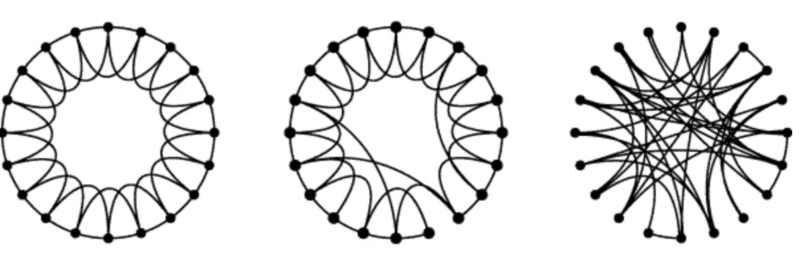
Small-World Model = high clustering + short paths
Regular
Small-World
Random
Note:
Clustering implies edge “locality”
Randomness enables “shortcuts
p =0
p=1
p = probability of reconnecting uniformly
Clustering
Diameter
High
High
High
Low
Low
Low
Procedure:
start with a ring of n vertices, each connected to its k-nearest neighbors by undirected edges.
choose a node and the edge that connects it to its nearest neighbor in a clockwise.
reconnect with probability p this edge to a node chosen uniformly over the entire ring
Source: Watts, Duncan J., and Steven H. Strogatz. "Collective dynamics of ‘small-world’networks." nature 393.6684 (1998): 440-442.
Notes:
Procedure: start with a ring of n vertices, each connected to its k nearest neighbors by undirected edges.
We choose a node and the edge that connects it to its nearest neighbor in a clockwise sense. With probability p, we reconnect this edge to a vertex chosen uniformly at random over the entire ring.

Slide 30
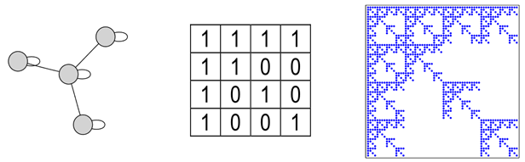
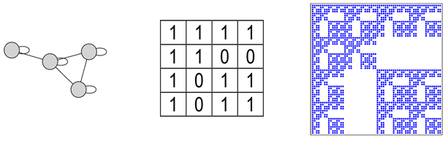
Kronecker Model
Small-World model captures the structure of many realistic networks
However, it does not produce the correct degree distribution
Solution: use the idea do self-similarity (the whole is in the parts)
Code to generate: https://github.com/BenjaminDHorne/Stochastic-Kronecker-Generator
Source: Leskovec, Jure, et al. "Kronecker graphs: an approach to modeling networks." Journal of Machine Learning Research 11.2 (2010).

Slide 31
Session-2 Graph Structural Features

Slide 32
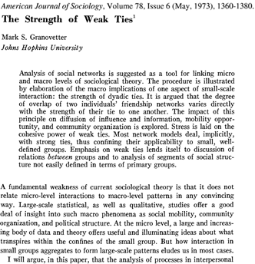
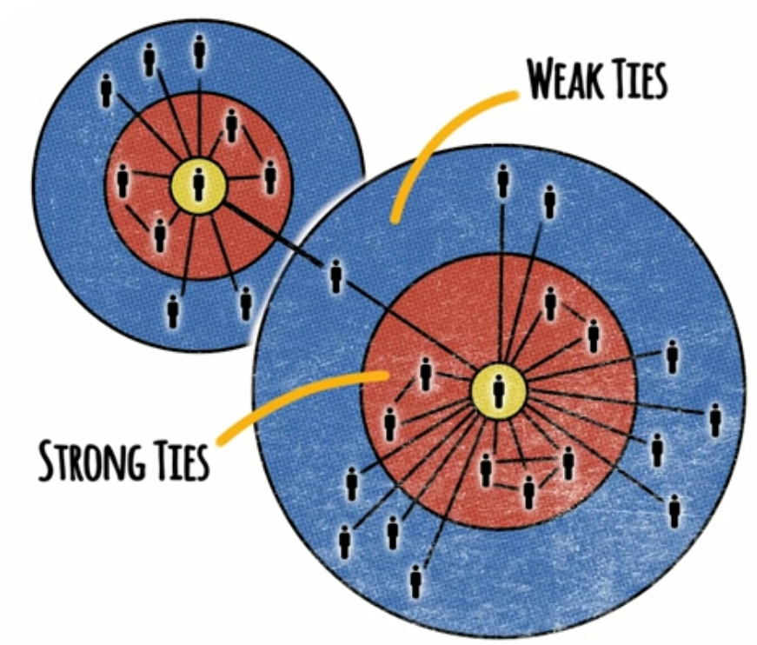
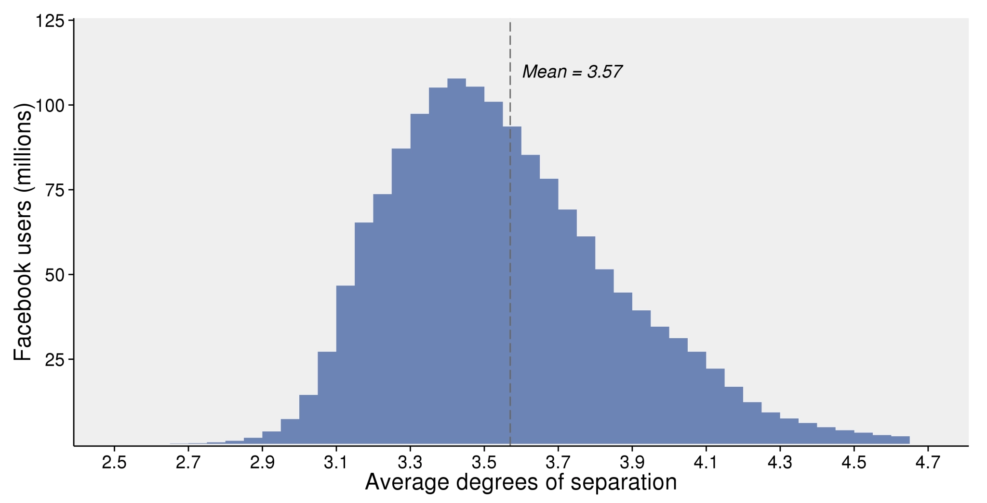

The Strength of Weak Ties [Granovetter 73]
Interesting facts:
Most people change jobs voluntarily
56% found new jobs through personal contacts
3/4 of the highest income categories
More difficult to change if>5 years in a job
People with 2 to 5 years in a job were more likely to find jobs through weak ties
source: Interview with Mark Granovetter at Stanford - https://www.youtube.com/watch?v=g3bBajcR5fE&pbjreload=101
A
Why?
B
C
D
Instant global communication
Triads tend to form -> increasing the spread of information within a cluster
Figure 1. Estimated average degrees of separation between all people on Facebook.
Shrinking average shortest paths
JJ Ying https://unsplash.com/photos/8bghKxNU1j0
https://research.fb.com/blog/2016/02/three-and-a-half-degrees-of-separation/
Notes:
Acquaintances connect us to other groups, so in a sense, they are our windows to the world.
Most people change jobs voluntarily, so they are looking for information that helps them make decisions, e.g., how is to work there? What about the tasks, the colleagues, the management, etc.
56% found new jobs through personal contacts
3/4 of the highest income categories (this effect was stronger in the top earners)
Difficult to change jobs for those who were >5 years
Average job to 2 to 5 years, were more likely to find jobs through weak ties
Strength of connections leads to clusters
Sources:
https://www.youtube.com/watch?v=g3bBajcR5fE&pbjreload=101
https://research.fb.com/blog/2016/02/three-and-a-half-degrees-of-separation/
JJ Ying https://unsplash.com/photos/8bghKxNU1j0

Slide 33
Session topics
Structure of Graph
Motifs – the building blocks
Graphlets – the landscape
Metrics
Centrality metrics
Structural membership metrics
Homophily metrics (Assortativity and Neighborhood)
2. Clustering
Community detection
Spectral clustering

Slide 34
Network metrics
Network-level metrics
Average node degree (degree distribution)
Average clustering
Average path length (diameter)
Node connectivity (distribution among components)
Node-level metrics
Centrality (degree-based): Katz, PageRank
Centrality (path-based): closeness and betweeness
Pair-wise metrics
Edge-overlap
Node equivalence (Regular and Structural)
Node similarity

Slide 35
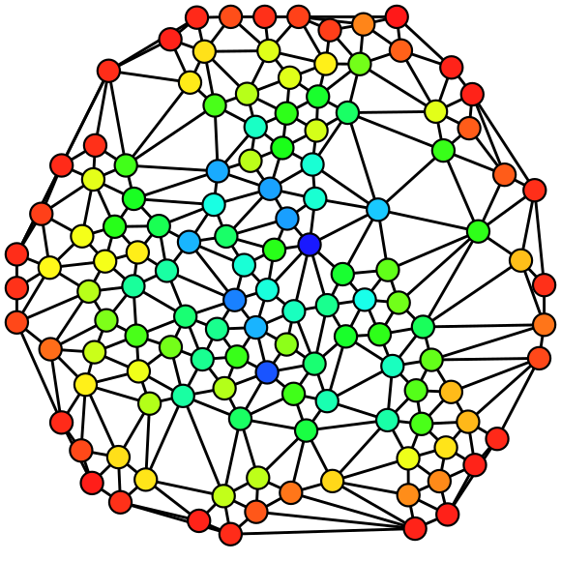
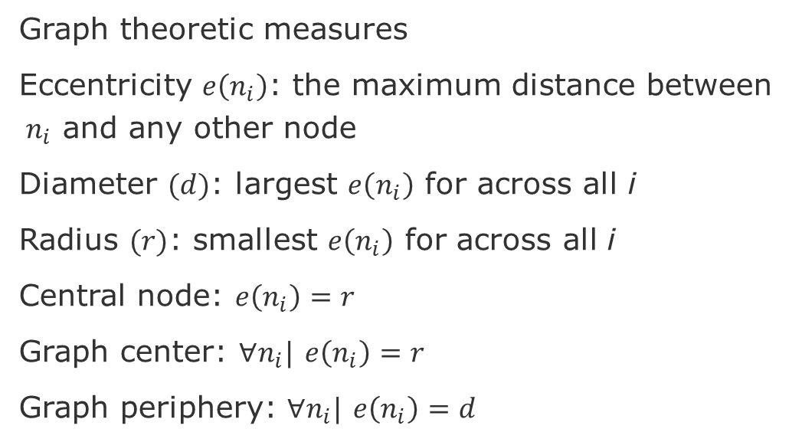
Graph theoretic measures
Graph theoretic measures
Eccentricity $e\left(n_{i}\right)$: the maximum distance between $n_{i}$ and any other node
Diameter $(d)$: largest $e\left(n_{i}\right)$ for across all i
Radius $(r)$: smallest $e\left(n_{i}\right)$ for across all i
Central node: $e\left(n_{i}\right)=r$
Graph center: $∀n_{i}|$ $e\left(n_{i}\right)=r$
Graph periphery: $∀n_{i}|$ $e\left(n_{i}\right)=d$
source: Wikipedia

Slide 36
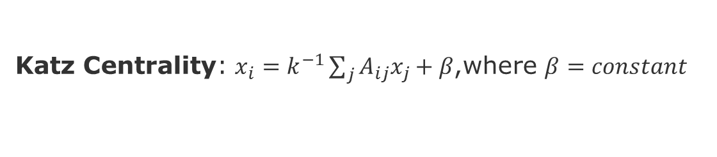
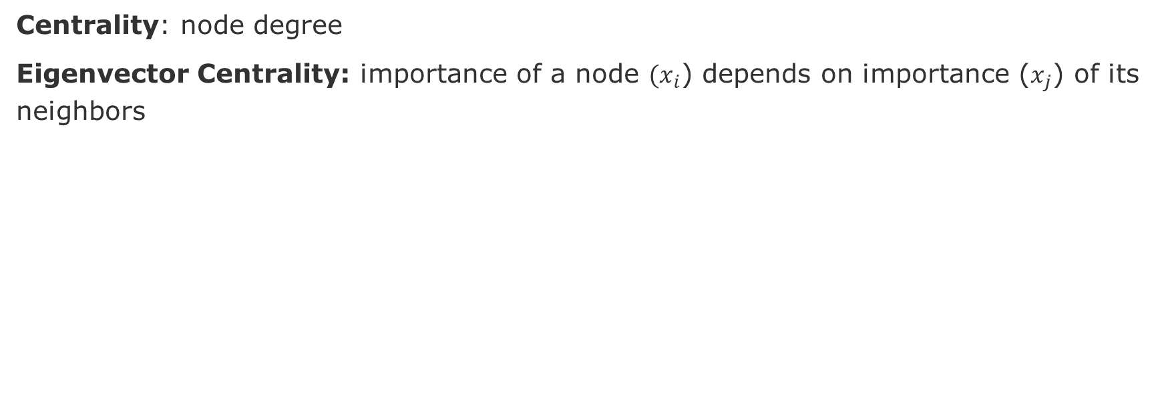
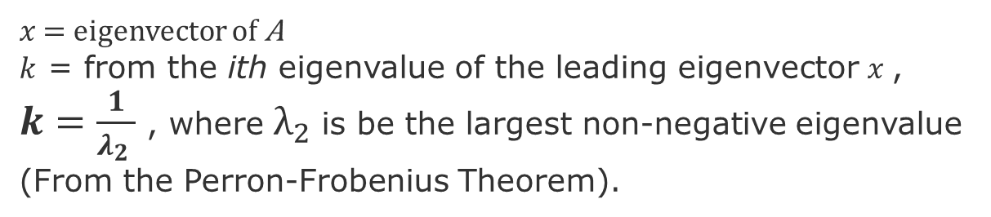
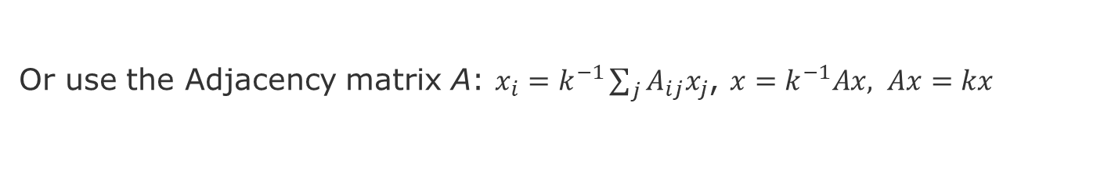
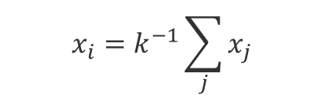
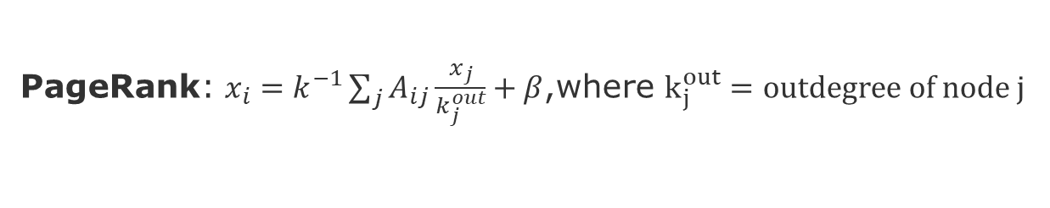
Centrality Metrics – Degree-based
Centrality: node degree
Eigenvector Centrality: importance of a node $(x_{i}$) depends on importance ($x_{j}$) of its neighbors
source: Wikipedia
$$x_{i}=k^{−1}\sum_{j}{x_{j}}$$
Or use the Adjacency matrix A: $x_{i}=k^{−1}\sum_{j}{A_{ij}x_{j}}$, $x=k^{−1}Ax, Ax=kx$
$x$ = eigenvector of A
$k$ = from the ith eigenvalue of the leading eigenvector $x$, $k=\frac{1}{λ_{2} }$ , where $λ_{2}$is be the largest non-negative eigenvalue (From the Perron-Frobenius Theorem).
Katz Centrality: $x_{i}=k^{−1}\sum_{j}{A_{ij}x_{j}}+β$,where $β=constant$
PageRank: $x_{i}=k^{−1}\sum_{j}{A_{ij}\frac{x_{j}}{k_{j}^{out}}}+β$,where $k_{j}^{out}=outdegree of node j$
Newman, Mark. Networks. Oxford university press, 2018.
Borgatti, Stephen P., and Martin G. Everett. "A graph-theoretic perspective on centrality." Social networks 28.4 (2006): 466-484.
Notes:
Caveats of Eigenvector centrality: nodes with outgoing edges only will have centrality zero, acyclic graphs,
Caveat of Katz Centrality, Amazon pointing to many sellers

Slide 37
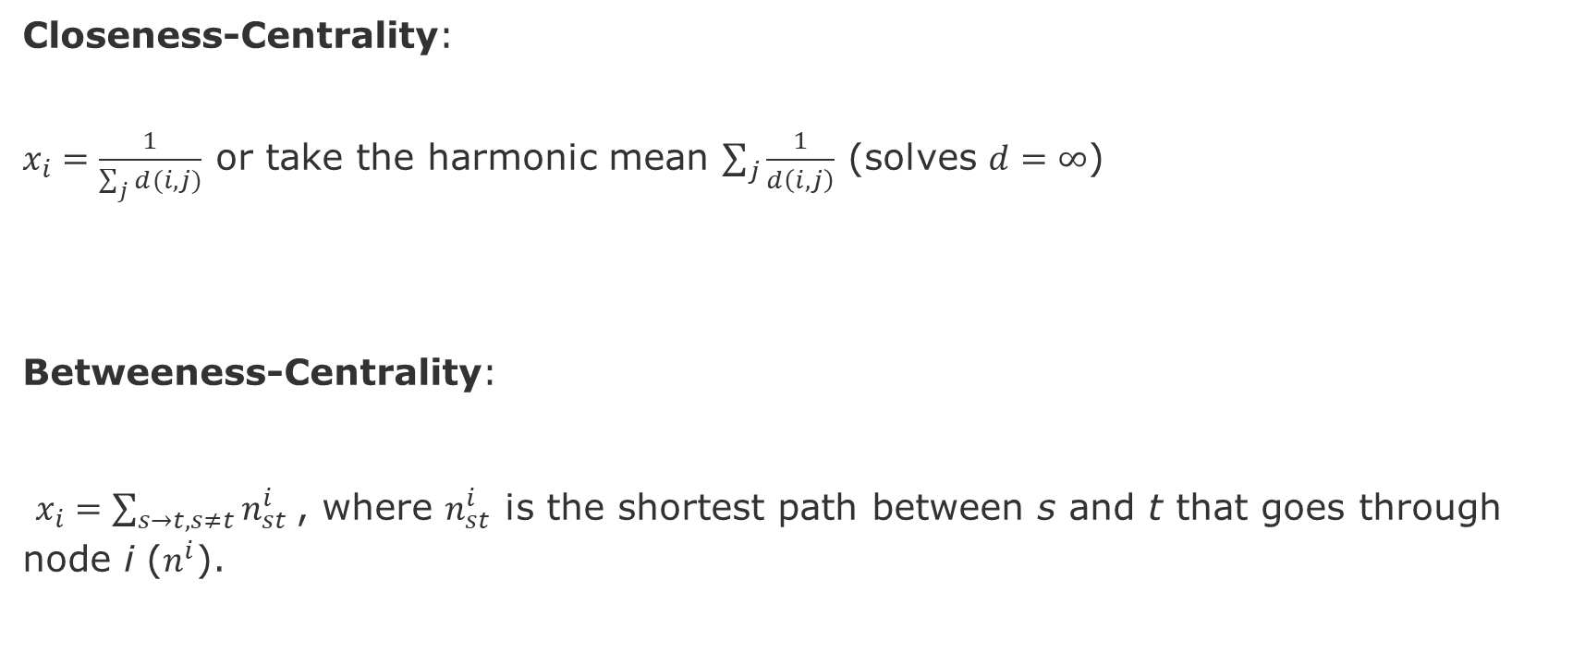
Centrality Metrics – Path-Based
source: Wikipedia
Closeness-Centrality:
$x_{i}=\frac{1}{\sum_{j}{d(i,j)}}$ or take the harmonic mean $\sum_{j}{\frac{1}{d\left(i,j\right)}}$ (solves $d=∞$)
Betweeness-Centrality:
$x_{i}=\sum_{s→t, s≠t}{n_{st}^{i}}$, where $n_{st}^{i}$ is the shortest path between s and t that goes through node i ($n^{i}$).
Newman, Mark. Networks. Oxford university press, 2018.
Borgatti, Stephen P., and Martin G. Everett. "A graph-theoretic perspective on centrality." Social networks 28.4 (2006): 466-484.

Slide 38
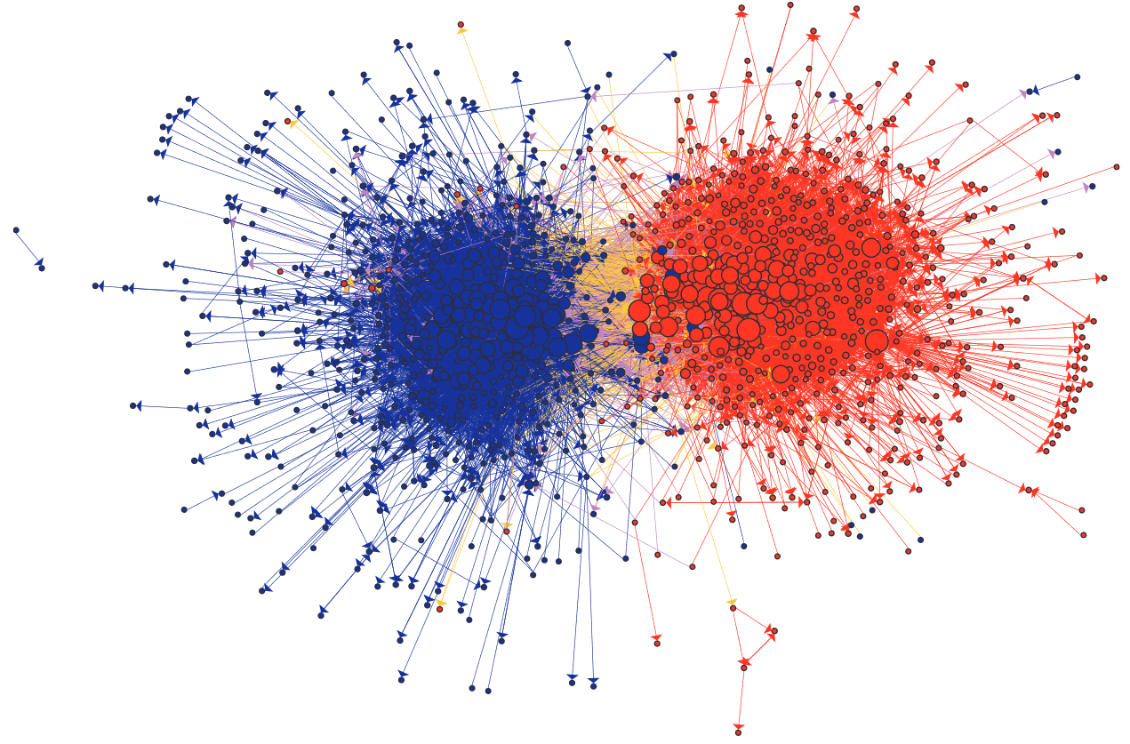
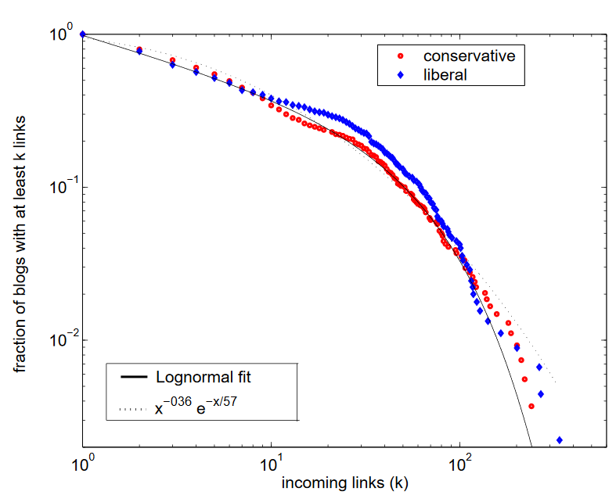
Political Blogosphere [Adamic & Glance 2005]
Cumulative distribution of incoming links for political blogs by category
Similar distributions can be fit with lognormal or exponential functions.
Larger blogs are more central
Homophily
Yellow links show blogs from opposite views commenting on each other
Source: Adamic, Lada A., and Natalie Glance. "The political blogosphere and the 2004 US election: divided they blog." Proceedings of the 3rd international workshop on Link discovery. 2005.
Notes:
The lack of overlap in lib-
eral and conservative interests has previously been observed
in purchases of political books on Amazon.com [8]. This
brings about the question of whether we are witnessing a
cyberbalkanization [11, 13] of the Internet, where the prolif-
eration of specialized online news sources allows people with
different political leanings to be exposed only to information
in agreement with their previously held views.
liberal and conservative
blogs did indeed have different lists of favorite news sources, people, and topics to discuss, although they occasionally
overlapped in their discussion of news articles and events.
The division between liberals and conservatives was further
reflected in the linking pattern between the blogs, with a
great majority of the links remaining internal to either lib-
eral or conservative communities.

Slide 39
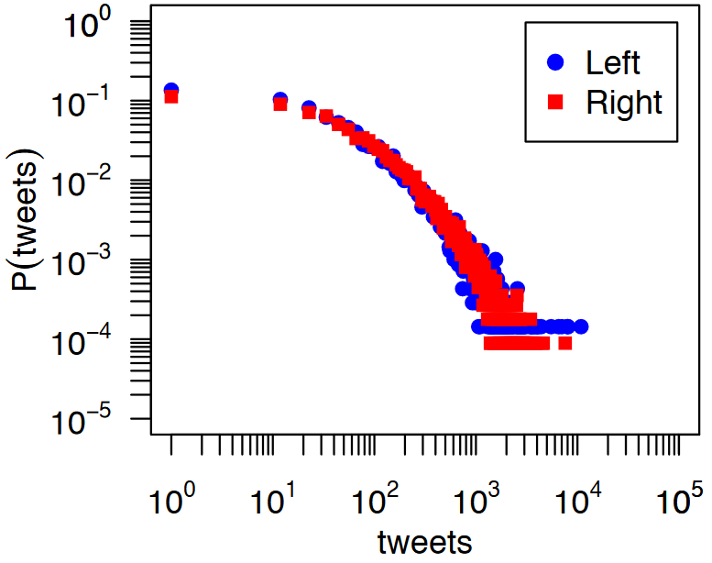
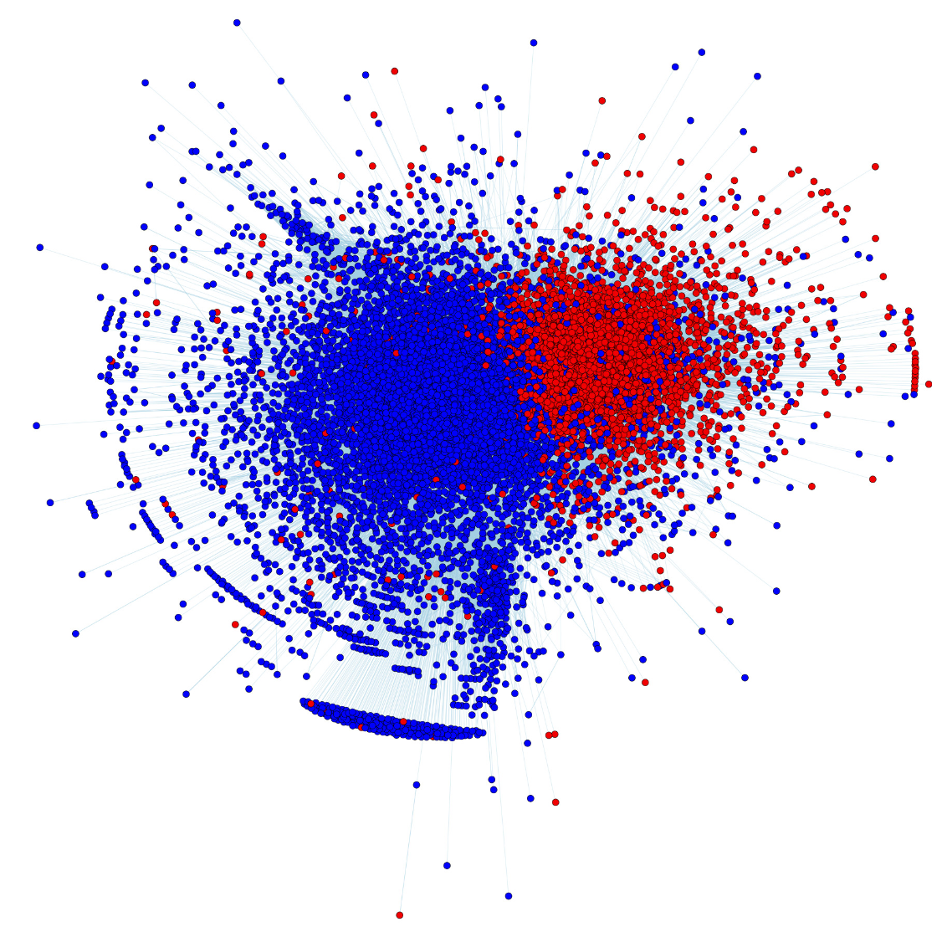
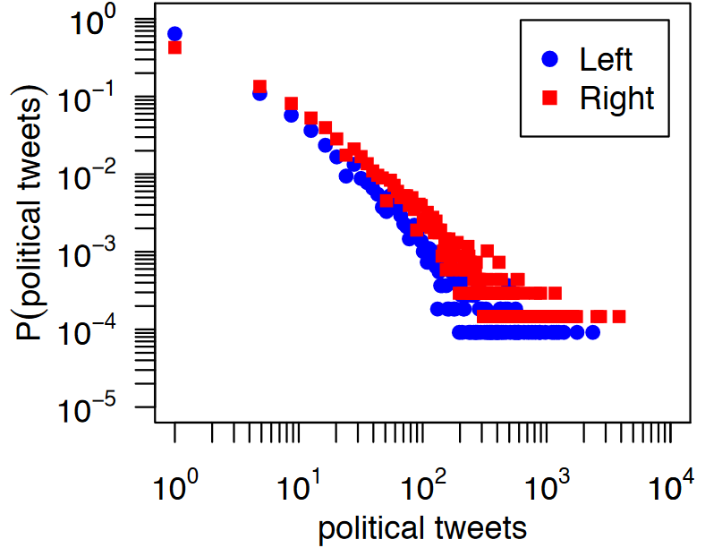
Partisan Asymmetries in Twitter [Conover et al. 2012]
Both groups produce same amount of tweets per capita
tweets = number of tweets a user posts
P(tweets) probability of a user
Right-leaning produce 2x more political content
One or more political hash tags
Right-leaning= 22% of tweets
Left-leaning= 12% of tweets
source: Conover, Michael D., et al. "Partisan asymmetries in online political activity." EPJ Data Science 1.1 (2012): 6.
Notes:
right-leaning users were almost twice as likely to create political content, with22%of all tweets produced by right-leaning userscontaining one or more of the political hashtags under study, compared to only12%for left-leaning users.

Slide 40
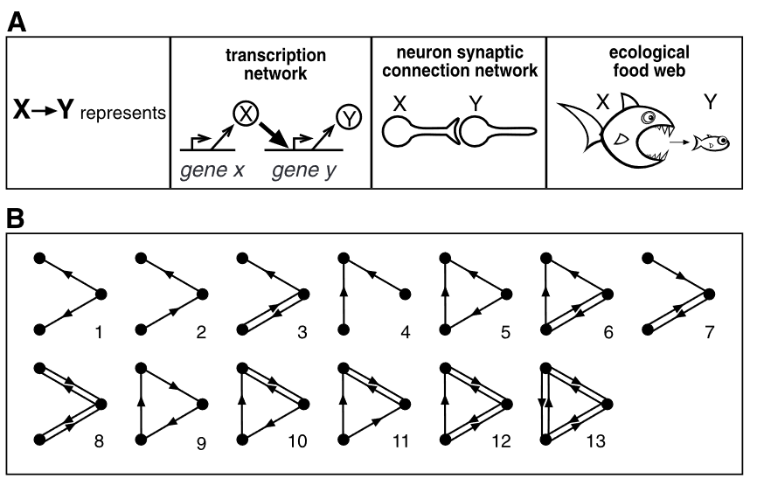


Motifs [Milo 2002]
Remarks
Number of motifs grow exponentially with the number of edges
Real networks tend to be rich in motifs, whereas Random networks not.
As Real networks evolve, their motif count remains stable, whereas in Random networks, it collapses.
This might suggest that motifs provide struture to the proper functioning of these networks
[Milo 2002] Milo, R. et al. Network motifs: Simple building blocks of complex networks. Science 298, 824–827 (2002).

Slide 41


Motifs in real networks
Biological
Technological
Milo, R. et al. Network motifs: Simple building blocks of complex networks. Science 298, 824–827 (2002).

Slide 42



Motif counting – ESU (FANMOD) algorithm [Wernicke 2006]
EXT set of all the nodes that :
are adjacent to at least one of the nodes in SUB (guarantees expansion is a connected graph)
their numerical labels must be larger than the label of first element in SUB. (guarantees termination)
Many other algorithms have bee developed and tested
[Wernicke 2006] Wernicke S (2006). "Efficient detection of network motifs". IEEE/ACM Transactions on Computational Biology and Bioinformatics. 3 (4): 347–359.
Author: CC BY-SA 3.0, https://en.wikipedia.org/w/index.php?curid=36822191
https://en.wikipedia.org/wiki/Network_motif#Motif_discovery_algorithms
Notes:
FANMOD == ESU

Slide 43
Motif caveats
Caveats
Stability of a network structure not necessary imply function stability [Igram et al. 2006]
Network structure not always imply function [Voigt et al. 2005]
Static analysis might hide the relationship between structure and function
Temporal network motifs have been investigated [Braha & Bar-Yam 2009][Holme & Saramäki 2012]
[Braha & Bar-Yam 2009] Braha D., Bar-Yam Y. (2009). “Time-Dependent Complex Networks: Dynamic Centrality, Dynamic Motifs, and Cycles of Social Interactions.” In: Gross T., Sayama H. (eds) Adaptive Networks. Understanding Complex Systems. Springer, Berlin, Heidelberg
[Holme & Saramäki 2012] Holme, P., & Saramäki, J. (2012). Temporal networks. Physics reports, 519(3), 97-125.
[Ingram et al. 2006] Ingram PJ, Stumpf MP, Stark J (2006). "Network motifs: structure does not determine function". BMC Genomics. 7: 108.
[Voigt et al. 2005] Voigt CA, Wolf DM, Arkin AP (2005). "The Bacillus subtilis sin operon: an evolvable network motif". Genetics. 169 (3): 1187–202.

Slide 44

Motif-based spectral clustering
Goal: find clusters of motifs,
How: find clusters that minimize the number of motif that are cut
Definitions
Motif-cuts: number of motifs whose at least one edge is cut by the clustering
Motif-volume: number of nodes participating in a certain motif type
Motif Conductance: $φ_{M}\left(S\right)=\frac{MotifCuts}{MotifVolume}$, where S is the set of nodes that minizes conductance.
This is an NP-Hard problem... One approximation is the Motif-based Spectral Clustering:
Step-1 Preprocessing – create a weighted graph W by counting the number of times a motif edge appears
Step-2 Decomposition – use standard special clustering on the Weighted graph
Step-3 Grouping – same as spectral clustering
Lu, Zhenqi, Johan Wahlström, and Arye Nehorai. "Community detection in complex networks via clique conductance." Scientific reports 8.1 (2018): 1-16.
Notes:
Lu, Zhenqi, Johan Wahlström, and Arye Nehorai. "Community detection in complex networks via clique conductance." Scientific reports 8.1 (2018): 1-16.

Slide 45

Graphlets
Automorphism orbits 0,1,2, . . . , 72 for the thirty 2, 3, 4, and 5-node graphlets G0,G1, . . . ,G29. In a graphlet Gi, i 2 {0,1,. . .29}, nodes belonging to
the same orbit are of the same shade
source: Pržulj, N., Biological network comparison using graphlet degree distribution, Bioinformatics, 23, 2, 2007, pp, e177–e183

Slide 46


Modularity (Q) – quality of clustering
Modularity (Q) fraction of the edges within the given groups minus the expected such fraction if edges were distributed at random. It is defined as [Newman 2004]:
Actual connection between i and j
$$Q=\frac{1}{2m}\sum_{i,j}{(A_{i,j}−\frac{k_{i}k_{j}}{2m})} δ\left(c_{i},c_{j}\right),$$
If nodes were randomly connected
(null model)
where:
$m$ = total number of edges
$A_{i,j}$= weight of the edge between $i$ and $j$
$k_{i}=\sum_{j}{A_{i,j}}$ is sum of the weighted edges attached to node $i$
$c_{i}$ = community of node $i$
$δ\left(c_{i},c_{j}\right)=1 if i and j∈same community c$
[Newman 2004] Newman, Mark EJ. "Analysis of weighted networks." Physical review E 70.5 (2004): 056131.
[Blondel et al. 2008] Blondel, Vincent D., et al. (2008), "Fast unfolding of communities in large networks.“, Journal of statistical mechanics: theory and experiment, 2008(9), pp.1-13.

Slide 47

Louvain Algorithm
Iterate until find the lowest modularity value

Slide 48


Community structure
Zachary’s Karate Club Split [Girvan et al. 2002]
Reddit Communities [Kumar, et al. 2018]
Instructor group
Club Admin group
[Girvan et al. 2002] Girvan, Michelle, and Mark EJ Newman. "Community structure in social and biological networks." Proceedings of the national academy of sciences 99.12 (2002): 7821-7826.
[Kumar et al. 2018] Kumar, S., Hamilton, W. L., Leskovec, J., & Jurafsky, D. (2018, April). Community interaction and conflict on the web. In Proceedings of the 2018 World Wide Web Conference (pp. 933-943).
Notes:
[Newman 2002] Newman, M. E. J. (2003). "Mixing patterns in networks". Physical Review E. American Physical Society (APS). 67 (2):

Slide 49



Spectral Clustering
1. Build Graph Laplacian representation:
$$Laplacian matrix (L)= Adjacency matrix (A) – Degree matrix (D)$$
2. Reduce Dimensionality:
Compute eigenvalues and eigenvectors of the L matrix
Use eigenvectors to map nodes to a reduced representation
3. Categorize:
Use the new representation, assign nodes to clusters
L = A-D
Further resources
Short Tutorial on Graph Laplacian: https://csustan.csustan.edu/~tom/Clustering/GraphLaplacian-tutorial.pdf
Lecture Slides: http://graphics.stanford.edu/courses/cs468-10-fall/LectureSlides/16_spectral_methods1.pdf
Tutorial on Spectral Clustering: nhttps://www.cs.cmu.edu/~aarti/Class/10701/readings/Luxburg06_TR.pdf

Slide 50



Homophily metrics
Definition: Preference to attach to nodes that are similar [Newman 2003]
Assortativity Coefficient (Pearson Correlation)
Neighborhood Connectivity
[Newman 2003] Newman, M. E. J. (2003). "Mixing patterns in networks". Physical Review E. American Physical Society (APS). 67 (2):

Slide 51






Node equivalence
$$j_{ij}=\frac{n_{ij}}{k_{i}+ k_{j}−n_{ij}}$$
Structural equivalence
Jaccard Similarity (intersection)
Cosine Similarity (distance)
Pearson Correlation
Euclidean Distance (dissimilarity)
Node overlap
Regular equivalence
Nodes that do not necessarily share neighbors, but have similar features
$$σ_{ij}=\frac{n_{ij}}{{\sqrt{k_{i}k_{j}}}_{i}}$$
$$O_{i,j}= \frac{| (N_{i}⋂N_{j})\backslash \{i,j\}|}{|(N_{i}⋃N_{j})\backslash \{i,j\}|}$$
i
j
i
j
i
j
$$O_{ij}=0$$
$$O_{ij}=1/3$$
$$O_{ij}=2/3$$

Slide 52
Suggested Exercises
Initial understanding about your graph data
What are possible the edges and nodes of your network?
What types of networks w.r.t. edge directionality?
What type of networks w.r.t. to node types?
Is your network possibly assortative, dissortative, or neither?
Which centrality metrics might make sense for you?
Are there communities/clusters that can be used as features?
Do you believe your graph will present high or low cluster coefficient?
What about the network diameter (low or high)?

Slide 53
Session-4 Messaging Passing and Belief Propagation

Slide 54

Fraud detection
eBay page listing the recent feedbacks for one user
Auction fraud
Among all the monetary losses reported, auction fraud accounted for 41%,with an average loss of $385.
Internet fraud complaint center: Ic3 2004 internet fraud-crime report.
2019 - Business Email Compromise $26 Billion Scam
https://www.ic3.gov/Media/Y2019/PSA190910
Other scenarios
Document classification
Fake news
Part speech tagging
Link prediction
Optical character recognition
Image/3D data segmentation
Entity resolution in sensor networks
source: Pandit, Shashank, et al. "Netprobe: a fast and scalable system for fraud detection in online auction networks." Proceedings of the 16th international conference on World Wide Web. 2007.

Slide 55
Goal: how to label my neighbors?
E
E
A
A
F
F
B
H
B
H
C
G
C
G
D
D

Slide 56
Lecture topics
Relational Classifier
Iterative Classifier
Belief Propagation
Main sources of these slides
- Lecture-6 of CS224W: Machine Learning with Graphs (Stanford / Fall 2019): http://web.stanford.edu/class/cs224w/
- Slides of talk at ICDM 2016. “Edge Weight Prediction in Weighted Signed Networks”:
https://cs.stanford.edu/~srijan/wsn/

Slide 57
Iterative Classifiers
General Algorithm
Bootstrap
Convert each node i to a flat vector ai
Use the local classifier $f(a_{i})$ (kNN, SVM, etc.) to find best value for label $Y_{i}$
Iterate
Foreach node i
update vector ai
update label $Y_{i}$ to $f(a_{i})$
Repeat until node labels converge or $max⁡_iterations$
Caveats
Convergence not guaranteed
Model ignores graph node features

Slide 58
Relational and Collective Classification
MarKov Property
Label $Y_{i}$ of node i depends on its neighbors $N_{i}$
$$P\left(Y_{i} | i\right)=P(Y_{i}|N_{i})$$
General Algorithm
Run local classifier to assign initial labels
Predicts labels using node features (no graph features)
Capture correlations between each pair of nodes
Predict labels based on neighbors’ labels (relational classifier)
Propagate these correlations through the graph
Iterate by applying the relational classifier until convergence to a probability of each node being of a certain label $P(Y_{i}=c)$
Caveats
Convergence not guaranteed
Model ignores graph features
$$P(Y_{i}=c)=\frac{1}{\left|N_{i}\right|}\sum_{ij∈N}{A_{ij}}P(Y_{i}=c)$$

Slide 59
Goal: how to label my neighbors?
75%
75%
E
E
E
100%
100%
A
A
A
75%
F
F
50%
F
B
H
B
H
B
H
100%
C
G
C
G
C
D
D
G
85%
D
100%
75%
85%
75%

Slide 60

Limitations of local features
Assumptions:
Neighboring nodes are more likely to share the same label
Nodes on the same structure (cluster) are more likely to share the same label
1
1
?
source: Zhou, D., Bousquet, O., Lal, T. N., Weston, J., & Schölkopf, B. (2004). Learning with local and global consistency. Advances in neural information processing systems - NIPS, 16(16), 321-328.
Notes:
https://networkx.org/documentation/stable//reference/algorithms/node_classification.html

Slide 61

Combining local and global features [Zhou et al. 2004]
Goal: Label nodes $x_{i}$ using a set of labels L
Algorithm
where
$x_{i}$ is a node i
D is the degree matrix (diagonal matrix whose diagonal is the sum of all columns of the row of the Adjacency matrix A)
F(t) is the matrix of labels for the nodes
$Y_{ij}$ = 1 if $x_{i}$ is labeled as $y_{i}=j$ , otherwise, $Y_{ij}=0$
source: Zhou, D., Bousquet, O., Lal, T. N., Weston, J., & Schölkopf, B. (2004). Learning with local and global consistency. Advances in neural information processing systems - NIPS, 16(16), 321-328.

Slide 62


Rating reliability [Kumar et al. 2016]
-0.2
+0.1
-0.9
+1
Positive edges: Trust, Like, Support, Agree
Negative edges: Distrust, Dislike, Oppose, Disagree
Weights: Strength of the relation
Fairness [0,1]: how reliable a user is in rating others, i.e., gives “correct” ratings to other users.
Goodness [-1,1]: how fair user rate it, i.e., user gets high ratings from fair users.
sources:
https://cs.stanford.edu/~srijan/wsn/
Kumar, Srijan, et al. "Edge weight prediction in weighted signed networks." ICDM, IEEE, 2016.

Slide 63

Goodness
W(u,v)
Fairness
f(u)
Goodness
g(v)
Weighted incoming rating
sources:
https://cs.stanford.edu/~srijan/wsn/
Kumar, Srijan, et al. "Edge weight prediction in weighted signed networks." ICDM, IEEE, 2016.

Slide 64

Fairness
W(u,v)
Fairness
f(u)
Goodness
g(v)
Average deviation of user u’s ratings
Deviation of rating from goodness
sources:
https://cs.stanford.edu/~srijan/wsn/
Kumar, Srijan, et al. "Edge weight prediction in weighted signed networks." ICDM, IEEE, 2016.

Slide 65

Fairness and Goodness Algorithm
Initialization
Update
Goodness
Update
Fairness
sources:
https://cs.stanford.edu/~srijan/wsn/
Kumar, Srijan, et al. "Edge weight prediction in weighted signed networks." ICDM, IEEE, 2016.

Slide 66
Initialization: All Fair and All Good
f(u) = 1
f(u) = 1
g(v) = 1
f(u) = 1
g(v) = 1
f(u) = 1
g(v) = 1
f(u) = 1
f(u) = 1
sources:
https://cs.stanford.edu/~srijan/wsn/
Kumar, Srijan, et al. "Edge weight prediction in weighted signed networks." ICDM, IEEE, 2016.

Slide 67

Updating Goodness - Iteration 1
f(u) = 1
f(u) = 1
g(v) = 0.67
f(u) = 1
g(v) = 0.67
f(u) = 1
g(v) = -0.67
f(u) = 1
f(u) = 1
sources:
https://cs.stanford.edu/~srijan/wsn/
Kumar, Srijan, et al. "Edge weight prediction in weighted signed networks." ICDM, IEEE, 2016.

Slide 68

Updating Fairness - Iteration 1
f(u) = 0.58
f(u) = 0.92
g(v) = 0.67
f(u) = 0.92
g(v) = 0.67
f(u) = 0.92
g(v) = -0.67
f(u) = 0.92
f(u) = 0.92
sources:
https://cs.stanford.edu/~srijan/wsn/
Kumar, Srijan, et al. "Edge weight prediction in weighted signed networks." ICDM, IEEE, 2016.

Slide 69
Message Passing and Belief propagation

Slide 70


Message passing [Mckay 2003]
Counting soldiers in a snowstorm
Algorithm
1. If you are the front soldier in the line, say the number “one” to the soldier behind you.
2. If you are the rearmost soldier in the line, say the number “one” to the soldier in front of you.
3. If a soldier ahead of or behind you says a number to you, add “one” to it, and say the new number to the soldier on the other side.
3 (ahead me)+1 (behind me)+1(myself) = 5
[MacKay 2003] MacKay, D. JC.(2003), Information theory, inference and learning algorithms. Cambridge university press.

Slide 71


Message passing for Counting in a Graph [McKay 2003]
Algorithm
1. Count your number of neighbors $N$. Let $V$ be the running total of the messages you have received.
2. Keep count of the number of messages you have received from your neighbors, $m$, and of the values $v1, v2, …,v_{N}$of each of those messages.
3. If the number of messages you have received $m=N−1$, then identify the missing neighbor and tell them $V + 1$.
4. If the number of messages you have received is equal to $N$, then:
(a) the number $V + 1$ is the required total.
(b) for each neighbor $n$ say to neighbor $n$ the number $V + 1 – v_{n}$.
[MacKay 2003] MacKay, D. JC.(2003), Information theory, inference and learning algorithms. Cambridge university press.

Slide 72



Message Passing for Path counting [McKay 2003]
Messages sent in the
forward paths $A→B$
The five paths $A→B$
Messages sent in the Forward (top-left) and Backward (bottom-right) paths
Probability of passing through a node: $P_{i}=\frac{T_{i}}{T}$
$T_{i}$= number of paths through a node $i$,
$T_{i}=Messages from backwards ∗Messages from forwards$
$T=\sum_{i}{T_{i}}$
[MacKay 2003] MacKay, D. JC.(2003), Information theory, inference and learning algorithms. Cambridge university press.

Slide 73






Message Passing – Viterbi algorithm [McKay 2003]
Find the path with lowest cost
Algorithm
Set the cost of first node to zero
As a node learns the costs of its predecessors, it passes these costs to its descendants
As the message passes along each edge in the graph, the cost of that edge is added
When conflicting costs arrive, take the minimum (that is why this algorithm also called min-sum)
[MacKay 2003] MacKay, D. JC.(2003), Information theory, inference and learning algorithms. Cambridge university press.

Slide 74

Generalized Distributive Law (GDL)
GDL synthesis of the work in:
information theory
digital communications
Signal processing
statistics
artificial intelligence communities
Algorithms:
Baum-Welch Algorithm (HMM)
Fast Fourier transform (FFT) on any finite Abelian group
Gallager–Tanner–Wiberg decoding algorithm
Viterbi’s algorithm
BCJR algorithm
Pearl’s “belief propagation” algorithm
Aji, Srinivas M., and Robert J. McEliece. "The generalized distributive law." IEEE transactions on Information Theory 46.2 (2000): 325-343.

Slide 75
Loopy belief propagation
Label-label Potential matrix $ψ$:
captures the dependencies between nodes
$ψ\left(Y_{i},Y_{j}\right)$ = probability of node i being in state $Y_{i}$ given that j is at state $Y_{j}$
Prior belief $φ\left(Y_{i}\right)$of node i being at state $Y_{i}$
$m_{i→y}\left(Y_{j}\right)$is the i's estimate of j being in state $Y_{j}$
$S$ = set of all states
$$m_{i→y}\left(Y_{j}\right)=α\sum_{Yi∈S}{ψ\left(Y_{i},Y_{j}\right)φ\left(Y_{i}\right) \prod_{k∈N_{i}\backslash j}{m_{k→i}(Y_{i}) }}$$
Sum over all states
Prior
All messages sent by neighbors of node i in the previous iteration
Label-label potential
Advantages
Easy to program and parallelize execution
Applies to any graphical model with different types of potential relationships between nodes
Caveat: no guarantee of convergence

Slide 76

Examples Loopy belief propagation
E
$$m_{i→y}\left(Y_{j}\right)=α\sum_{Yi∈S}{ψ\left(Y_{i},Y_{j}\right)φ\left(Y_{i}\right) \prod_{k∈N_{i}\backslash j}{m_{k→i}(Y_{i}) }}$$
A
F
Example computing the message from A do D :
B
H
$$m_{A→D}\left(Y_{j}\right)=α\sum_{Yi∈S}{ψ\left(Y_{A},Y_{D}\right)φ\left(Y_{A}\right)m_{E→A}(Y_{A})m_{C→A}(Y_{A}) }$$
C
G
D
source:
Pandit, Shashank, et al. "Netprobe: a fast and scalable system for fraud detection in online auction networks." Proceedings of the 16th international conference on World Wide Web. 2007.
red triangles = fraudsters,
yellow diamonds = accomplices,
white ellipses = honest nodes,
gray rounded rectangles = unbiased node

Slide 77
Other applications of loopy belief propagation
Improve in standard graph mining tasks:
Node ranking
Anomaly detection
Clustering
Community detection
Sentiment prediction
Information diffusion

Slide 78
Session-5 Graph Embeddings

Slide 79
Motivation
Data Preprocessing
Feature engineering
Prediction
Intervention
Collect data
Remove Outliers
Resolve Missing data
Build graphs
Network metrics
Similarity metrics
Clustering
Filtering
Node classification
Link prediction
Graph classification
Resolve Selection Bias
Isolate Confounding
Estimate effects of interventions
Systematize & Automate this step
Why would I want features that are independent of prediction tasks?
Learned Features might produce novel insightful descriptions of the networks
Learned Features might better generalize across tasks
I do not know the prediction tasks yet

Slide 80
Node Embedding
N$ode_{G}$
E
A
F
B
H
C
G
D
$$Mapping Function Φ:G→ℝ^{n}$$
$$Feature_{j}$$
Unsupervised Learning
Learned features that represent node similarity
Similarity function is domain-specific
Find nodes by traversing the graph
$$N_{nodes }X N_{features}$$

Slide 81
Optimization Problem
Goal: Find the features that the best predictors of the closest node i neighbors $Nr(i)$
$$\sum_{i∈N}{\log{P(N_{r}(i)|Φ_{i})}}$$
Objective Function:
(log-likelihood)
Neighbors of node i
Features of node i
How to select neighbors?
Traverse the graph

Slide 82






Types of embeddings
Sources
Cai, H., Zheng, V. W., & Chang, K. C. C. (2018). A comprehensive survey of graph embedding: Problems, techniques, and applications. IEEE Transactions on Knowledge and Data Engineering, 30(9), 1616-1637
Perozzi, B., Al-Rfou, R., and Skiena, S. (2014) "Deepwalk: Online learning of social representations." Proceedings of the 20th ACM SIGKDD international conference on Knowledge discovery and data mining.
Grover, A., & Leskovec, J. (2016) "node2vec: Scalable feature learning for networks." Proceedings of the 22nd ACM SIGKDD international conference on Knowledge discovery and data mining.
Qiu, Jiezhong, et al. (2018) "Network embedding as matrix factorization: Unifying deepwalk, line, pte, and node2vec." Proceedings of the Eleventh ACM International Conference on Web Search and Data Mining.
Grohe, M., (2020). "word2vec, node2vec, graph2vec, x2vec: Towards a theory of vector embeddings of structured data." Proceedings of the 39th ACM SIGMOD-SIGACT-SIGAI Symposium on Principles of Database Systems. 2020.

Slide 83
Session Topics
Softmax
DeepWalk
Node2Vec
Graph Embeddings

Slide 84



Random Walks [Perozzi, Al-Rfou & Skiena 2014]
Goal: learn a latent representation of node i ($v_{i}$) based on the features of the other nodes
, where $Φ\left(v_{i}\right)$is a feature vector of node i
Recompute the likelihood function using a different set of neighbor nodes from the random walk $W_{v_{i}}$
Recompute the gradient ($\frac{∂J}{∂Φ}$) function
Update the embedding in an $α$ step of the gradient
On random walk for each node $v_{i}$
Update the embedding of node $v_{i}$
Perozzi, B., Al-Rfou, R., and Skiena, S. (2014) "Deepwalk: Online learning of social representations." Proceedings of the 20th ACM SIGKDD international conference on Knowledge discovery and data mining

Slide 85




Node2Vec [Grover & Leskovec 2016]
Goal: Same goal - create embeddings that predict how close will a node be to its neighbors
Insight: Parameterizable neighborhood $N_{r}(i)$
$$W=\left\{\begin{matrix}Nodes & Visiting Weight & \\ E & 1/q & \\ \begin{aligned}D \\ C \\ B\end{aligned} & \begin{aligned}1/p \\ 1/q \\ 1\end{aligned} & \end{matrix}\right\}$$
E
1/q
E
A
A
1
F
F
B
1/q
B
H
H
1/p
C
C
G
G
D
D
Breadth First Search (local view)
Probability of Breadth First Search Walk:
Low value of p
Probability of Breadth First Search Walk:
Low value of q
Depth First Search (global view)
Grover, A., & Leskovec, J. (2016) "node2vec: Scalable feature learning for networks." Proceedings of the 22nd ACM SIGKDD international conference on Knowledge discovery and data mining.

Slide 86





Softmax [1]
where, $x∈ℝ$features and $θ$parameters to optimize
where, $y$are the classes of$x$
Cost function $J$
Gradient of $J$
[1] http://ufldl.stanford.edu/tutorial/supervised/SoftmaxRegression/

Slide 87
Graph Embedding Methods
Aggregation:
$$EmbeddingOfDocument= \sum_{i∈Words}{EmbeddingOfWord_{i}}$$
Just sum over the Node Embeddings that are in the graph/subgraph (similar of what we have in language
Virtual node:
Create a virtual that connects all nodes in a subgraph. Runs node embeddings for all nodes in the subgraph and the virtual node. The embedding of the virtual node will be the embedding of the subgraph.
V2
V1
E
A
B
F
C
D

Slide 88




Graph Embedding Methods – Anonymous Walks
Probability of a walk $a_{i}$
Goal: predict $W_{4}$by its surrounding context walks (${w_{1},}_{ }…,w_{3}$) and a graph vector $d$.
prob. of a random walk $w$
$p\left(w\right)=\prod_{e∈W}{p(e)}$
prob. of anonymous walk $a_{i}^{u}$
keep track of the order in which the nodes were visited.
Advantages
Task-independent
Scalable
Ivanov, S., & Burnaev, E. (2019). Anonymous walk embeddings. ICML, arXiv preprint arXiv:1805.11921.

Slide 89
Session-6 PageRank and Markov Chains

Slide 90

Breaking news on Learning on Networks
Goal: predict the protein’s constituent parts = a string of different amino acids and map out the many twists and folds of its eventual shape. Poor predictions in 1980s and 1990s.
AphaFold-1 (2018):
1- apply deep learning to structural and genetic data to predict the distance between pairs of amino acids in a protein
2- use this information to build ‘consensus’ model of how the protein should look like
[Nature 2020] It will change everything: DeepMind’s AI makes gigantic leap in solving protein structures - Google’s deep-learning for determining the 3D shapes of proteins https://www.nature.com/articles/d41586-020-03348-4
Can a Computer Devise a Theory of Everything?*
The Feynman Lectures on Physics -> used them to generate data that was then fed to a neural network. DL was able to recover all 100 formulas
Data from the Large Hadron Collider -> the system successfully identified and distinguished between quarks and gluons, without ever knowing what either was.
*It might be possible, physicists say, but not anytime soon. And there’s no guarantee that we humans will understand the result…
NY Times - https://www.nytimes.com/2020/11/23/science/artificial-intelligence-ai-physics-theory.html

Slide 91

Motivation [Cisco Annual Internet report 2020]
Nearly 2/3 of the global population will have Internet access by 2023, i.e., 5.3 billion total Internet users (66% of global population) and up from 3.9 billion (51% of global population) in 2018.
2023:
29.3 billion networked devices (compared with 18.4 billion in 2018)
14.7 billion IoT connections (33% growth over 2-18)
Connected home apps will have the largest share and connected cars will be the fastest growing application type.
Connected home apps will have nearly half or 48% of IoT share by 2023 and Connected car applications will grow the fastest at 30% over the forecast period (2018–2023).
How to make predictions on networks of hundreds of billions of nodes which are constantly evolving?
We need to sample effectively = node ranking
This allows better search and more efficient monitoring
Google PageRank takes few weeks for the crawlers to map of the entire web and a few hours to recompute the importance of pages.
[Cisco 2020] Cisco Annual Internet report , https://www.cisco.com/c/en/us/solutions/collateral/executive-perspectives/annual-internet-report/white-paper-c11-741490.html

Slide 92

What we want
If I spend time randomly surfing the web, assuming equal time between clicks, what percent of time would I be on each page? i.e., how important is each node?
$$\operatorname{Pr}\left(E\right)=\frac{1}{3}Pr\left(A\right)+\frac{1}{2}Pr\left(B\right)$$
Importance of a node (Pr):
In-links are less prone to be manipulated
Importance is proportional to its neighbors
Flow/Message passing way to computing
Hub
E
F
A
H
B
Lose, dangling node
(dead-end)
G
$\operatorname{Pr}\left(i\right)=\sum_{j∈Nr(i)}{\frac{1}{D_{j}}Pr\left(j\right)}$, where $D_{j}$ is the out-degree of node i
C
D
$$\operatorname{Pr}\left(B\right)=\frac{1}{1}Pr\left(D\right)$$
Authority
Add one more constraint $1=\sum_{i∈N}{Pr⁡(i)}$
Solve the system of equations:
$$\left[\begin{aligned}\begin{aligned}\operatorname{Pr}\left(A\right)=… \\ \operatorname{Pr}\left(B\right)=… \end{aligned} \\ … \\ \operatorname{Pr}\left(H\right)=… \\ 1=\sum_{i∈N}{Pr⁡(i)}\end{aligned}\right]$$
$$\operatorname{Pr}\left(D\right)=\frac{1}{3}Pr\left(A\right)+\frac{1}{2}Pr\left(E\right)+\frac{1}{2}Pr\left(B\right)+\operatorname{Pr}\left(C\right)$$
Caveat: this does not scale well for large graphs
Solution: we need to sample!

Slide 93
Sampling on Networks = Random Walking
Goal: model a random process in which the system transitions from one state to another at discrete time steps.
States are nodes
Transitions are edges
At each time,
there are $N$ states the system could be in.
we model the system as a vector $\vec{R_{t}}∈ℝ^{n}$ ,
$\vec{R_{t}}$represents the probability of being at any given state.
where, $t=0,1,2, …, T$ , where the “initial state" is the vector $\vec{R_{0}}$ .
the total probability of being at any given state should be 1, i.e.,$1=\sum_{i∈N}{{R_{t}}_{i}}$
A sequence of probability vectors$\vec{R_{0}},\vec{R_{1}},…,\vec{R_{t}}$ is called a Markov Chain

Slide 94
Intro to Discrete Time Markov Chains

Slide 95
Definitions for the DTMC project
Hidden elements
Events: infection, failures, rumor spread, toxic contamination, traffic accident, etc.
Entities: components, people, infrastructure, that have states and are affected by events
Observable elements
State (S):
operational (no failure/not infected): $So$
degraded (performance): $Sd$
unresponsive (disabled): $Su$
Transition (T): change from one state to another state (self-loops included)
State Traces
A sequence of states that happened within a given time horizon:
$ST_{1}=So_{1};So_{2};So_{3};Sd_{3};So_{3};So_{1};Sd_{1};Sd_{2};Su_{3};So_{1};So_{2};So_{3}$
Obtained from system logs, contact tracing (GPS), sensors (traffic, water pipes), etc.

Slide 96
Assumptions
Markov property
($S_{t+1}⊥S_{t−1 })| S_{t} or$
$P\left(S_{t+1},S_{t−1}\right)=P\left(S_{t+1}|S_{t}) P(S_{t−1}\right)$
Memoryless, we do not keep the information from previous states, but the state is rich enough to estimate the transition probabilities.
Events might cause other events
Root-causes of events are unknown, but should be able to estimate
Transitions might have prior probabilities

Slide 97
Example of Markov Chain
Markov matrix $M$
Also called stochastic matrix or transition matrix)
$M$ is a square matrix whose columns are probability vectors $\vec{x_{t}}$.
$$So_{1}$$
$$Sd_{1}$$
$$\vec{x_{t}}$$
$$Su_{1}$$
Source states
 | $$So_{1}$$ | $$Sd_{1}$$ | $$Su_{1}$$ | $$So_{2}$$ | $$Sd_{2}$$ | $$Su_{2}$$
$$So_{1}$$ | 0.15 | 0.50 | 0.25 | 0.80 | 0.0 | 0.25
$$Sd_{1}$$ | 0.05 | 0.25 | 0.0 | 0.0 | 0.0 | 0.0
$$Su_{1}$$ | 0.0 | 0.10 | 0.50 | 0.0 | 0.0 | 0.0
$$So_{2}$$ | 0.80 | 0.0 | 0.0 | 0.15 | 0.50 | 0.25
$$Sd_{2}$$ | 0.0 | 0.15 | 0.0 | 0.05 | 0.25 | 0.0
$$Su_{2}$$ | 0.0 | 0.0 | 0.25 | 0.0 | 0.25 | 0.50
$$∑$$ | 1.0 | 1.0 | 1.0 | 1.0 | 1.0 | 1.0
$$Su_{2}$$
$$So_{2}$$
$$Sd_{2}$$
Target states
Intentionally not showing the self-loops

Slide 98
Types of Traces
$$So_{1}$$
$$Sd_{1}$$
$$So_{1}$$
$$Sd_{1}$$
$$So_{1}$$
$$Sd_{1}$$
$$So_{1}$$
$$Sd_{1}$$
$$So_{1}$$
$$Sd_{1}$$
$$Su_{1}$$
$$Su_{1}$$
$$Su_{1}$$
$$Su_{1}$$
$$Su_{1}$$
$$Su_{2}$$
$$Su_{2}$$
$$Su_{2}$$
$$Su_{2}$$
$$Su_{2}$$
$$So_{2}$$
$$Sd_{2}$$
$$So_{2}$$
$$Sd_{2}$$
$$So_{2}$$
$$Sd_{2}$$
$$So_{2}$$
$$Sd_{2}$$
$$So_{2}$$
$$Sd_{2}$$
Normal operation
$(So_{1};So_{2};So_{1})$
Intermittent failure
($So_{1}→Sd_{1}→So_{1})$
($So_{2}→Sd_{2}→So_{2})$
Systemic degradation
($Sd_{1}→Sd_{2})$
Failure masking
$(Su_{1}→Su_{2}→So_{1})$
Failure cascade
$(Sd_{1}→Su_{1}→So_{2})$
$$(Sd_{1}→Sd_{2}→Su_{2})$$

Slide 99
Computation using a Markov Chain
A
B
Transition Matrix $M$
Uniform Prior probabilities before surfing
$$R_{o}$$
Probabilities after iteration 1
0.5
O.5
A
B
C
D
0.5
O.5
0.5
$$\left[\begin{matrix}0 & 0 & 0.5 \\ 1 & 0 & 0 \\ \begin{aligned}0 \\ 0\end{aligned} & \begin{aligned}0.5 \\ 0.5\end{aligned} & \begin{aligned}0 \\ 0.5\end{aligned}\end{matrix} \begin{matrix}0.5 \\ 0.5 \\ \begin{aligned}0 \\ 0\end{aligned}\end{matrix}\right]$$
X $\left[ \begin{matrix}0.25 \\ 0.25 \\ \begin{aligned}0.25 \\ 0.25\end{aligned}\end{matrix}\right]$
= $\left[ \begin{matrix}0.25 \\ 0.375 \\ \begin{aligned}0.125 \\ 0.25\end{aligned}\end{matrix}\right]$
D
C
= $\left[ \begin{matrix}0∗0.25+0∗0.25+0.5∗0.5+0.5∗0.5 \\ . \\ \begin{aligned}. \\ .\end{aligned}\end{matrix}\right]$
O.5
0.5
Next iteration
$\vec{R_{2}}=\left[ \begin{matrix}0.185 \\ 0.375 \\ \begin{aligned}0.185 \\ 0.250\end{aligned}\end{matrix}\right]$
$$... \lim_{t→∞}{M^{t}}\vec{R_{0}} \left[ \begin{matrix}0.217 \\ 0.348 \\ \begin{aligned}0.174 \\ 0.261\end{aligned}\end{matrix}\right]$$
A
B
C
D
Eigenvalues of $M$
A Markov chain has a stationary distribution if and only if the Markov chain is ergodic. If the Markov chain is ergodic, the stationary distribution is unique.

Slide 100
Markov Chain properties
Reducible: if it is possible to get to any state from any state.
Periodicity: a state in a Markov chain is periodic if the chain can return to the state only at multiples of some integer larger than 1. Thus, if we start at state i, the chain can return to this state i only at multiples of the period $T>1$. Conversely, if state i is aperiodic, then if $T = 1$.
Transient: if, given that we start in state i, there is a non-zero probability that the chain will never return to i.
Recurrent: if it is expected to return to state i within a finite number of steps.
Ergodicity: a state i is ergodic if it is aperiodic and positive recurrent. If all states in an irreducible Markov chain are ergodic, then the chain is said to be ergodic.
Absorbing State: a state i is called absorbing if it is impossible to leave this state. Therefore, the state i is absorbing if $pii = 1$ and $pij = 0 for i ≠ j$. If from every state we can reach an absorbing state, then the Markov chain is an absorbing Markov chain.
Notes:
Ergodicity (Ludwig Boltzmann) guarantees that starting from a random point, orbits will pass through any other point in space.

Slide 101
Dead-Ends [Brin, Page, Motwani & Winograd 99]
Super Node
Implications of a super node:
It creates a super connected component
Which has a unique stationary distribution $\vec{R_{s}}$
Which we can guarantee to reach regardless of initial state distribution $\vec{R_{0}}$
$$\lim_{t→∞}{M^{t}\vec{R_{o}}}= \vec{R_{s}}$$
Teleports
Hub
E
H
A
F
Lose, dangling node
(dead-end)
B
G
C
D
Authority
At each step:
With probability $α$, follow the link in the Markov Chain
With probability $1−α$, jump to some random page with probability $\frac{1}{N}$
Hence, the new ranking is computed as follows
$$\operatorname{Pr}\left(i\right)=\sum_{j∈Nr(i)}{\frac{α}{D_{j}}Pr\left(j\right)}+\frac{\left(1−α\right)}{N}$$
Page, L., Brin, S., Motwani, R., & Winograd, T. (1999). The PageRank citation ranking: Bringing order to the web. Stanford InfoLab.

Slide 102
Derivation of Transition matrix $M$ from Adjacency matrix $A$
For every row of $A$ that has no 1, replace each element for $\frac{1}{N}$
For all the other rows:
Divide each 1 occurrence in $A$ by the number of 1's in the row (which is the out-degree)
Multiply the resulting matrix by $(1−α)$
Add $\frac{α}{N}$ to every entry of the resulting matrix to obtain transition matrix $M$.

Slide 103
Suggested Exercises
Compute and compare graph metrics
Any metrics and networks of your choice
Predictions using traditional method
Any two methods of your choice
Node and Graph Feature Learning
Any two methods of your choice

Slide 104
Session-7 Graph Convolutional Networks

Slide 105
Quick recap
Metrics
Classification
Random Walk
Node and Graphs Embeddings
Graph Structure Learning
Why do we need Graph Neural Networks?
We need a way to scale without having to make large random walks in the graph

Slide 106
Session Topics
Example from Industry
Graph Convolutional Networks (GCN)
Relational GCN
Mathematical background
Laplacian
Chebshev Approximation
Softmax

Slide 107


Motivation – Uber Eats
https://eng.uber.com/uber-eats-graph-learning/

Slide 108


Outcomes

Slide 109

Pipeline

Slide 110


Bipartite Graph for Dish Recommendation
$U_{i}$users
$D_{i}$Dishes
Users connect to dishes by number of times they order a dish $D_{i}$
New users and new dishes are added every day
Each node has a feature (e.g., word2vec)

Slide 111

Margin Loss
For dish recommendation, the goal is to rank dishes for each user.
Goal is for the positive pair to surpass the negative pair

Slide 112

Loss with Low Rank Positives

Slide 113

Weighted pool aggregation
Aggregate neighborhood based on the edge weights

Slide 114



GNN key idea
Obtain a node representation by using a neural network to aggregate the information from the neighbors.
Output graph (depth =2 BFS)
Input graph
Do it recursively

Slide 115


Solution for Recursion = Message Passing
Every node has its own embedding at every layer
Each layer is how deep we go in the network
Input feature $x_{u}$ has layer K embeddings $h_{u}^{k}$
Layer-0 has the features of each node
$AGG$ = aggregation function
$NN B_{k}$= network self-embedding embedding
$NN W_{1}$= network 1
$NN W_{2}$= network 2
$h_{u}^{k}$= computed representations

Slide 116
Scalability
Message Passing in GNN allows to scale because:
We do not depend on the number of nodes in graph, but the number of neurons that we decide to use to compute de embeddings at each layer.
We can limit the number of neurons because all these nodes share the same network at each layer
This is the scalability that we do not have in the standard methods like Node2Vec, for instance.

Slide 117

Inductive capability
In many applications new nodes are constantly added to the graph
This would require constant retraining to update the embeddings
While this is difficult to do with traditional methods, GNN allows to retrain on the part affected

Slide 118
Number of Layers in a GCN
Each node can have on or multiple dimensions (depends on the features that we choose)
In a 2 GCN layer, each node pull the information from their neighbors two times.
The number of GCN layer tells how far the signal could travel.
In a 2 layer GCN, the signal travels to a maximum to a two hops from the node.

Slide 119




Steps
Message propagation
Feature aggregation
Enconding
Source: Zak Jost - https://www.youtube.com/watch?v=2KRAOZIULzw

Slide 120

Relational GCN
$$h_{i}^{l+1}=σ\left(\sum_{j∈N_{i}}{\frac{1}{c_{ij}}h_{j}^{l}W^{l}}\right)$$
, where:
$l$ is a layer
$σ$ is the sigmoid function
$N_{i}$are the neighbors of node $i$
$c_{ij}$ is normalizing constant
$h^{l}$ is the value of the node in the previous layer
$W^{l}$ is a linear projection matrix for layer $l$

Slide 121
Quick Math background based on Message Passing

Slide 122


Sum Operation
$$aggregate{\left(A_{i},X\right)}_{i}=A_{i} X=\sum_{j∈N}{A_{i,j}X_{j}}$$
This allow to compute the aggregate feature representation of the ith node as vector-matrix product. Computationally, this weighted sum is obtained by using the Adjacency matrix to adjust or weight the features of a node by its he connectivity (edges or neighbors).
The contribution of the jth node in the feature aggregation depends on value of the jth column of the ith row of A. Because A is the adjacency matrix, if this value is 1, then the jth node is a neighbor of the ith node.
A
X
1
$$\left[\begin{matrix}0 & 1 & 0 \\ 1 & 0 & 1 \\ 0 & 1 & 0\end{matrix}\right]\left[\begin{aligned}3 \\ 1 \\ 4\end{aligned}\right]=\left[\begin{aligned}\left(0\right)\left(3\right)+\left(1\right)\left(1\right)+(0)(4) \\ \left(1\right)\left(3\right)+\left(0\right)\left(1\right)+(1)(4) \\ \left(0\right)\left(3\right)+\left(1\right)\left(1\right)+(0)(4)\end{aligned}\right]=\left[\begin{aligned}1 \\ 7 \\ 1\end{aligned}\right]$$
(4,1)
3
2
(3,1)
(1,7)
(node feature, aggregated feature)
Hence, the contribution of each neighbor depends only on the connectivity specified in the adjacency matrix A
Notes:
Nice explanations here:
https://towardsdatascience.com/how-to-do-deep-learning-on-graphs-with-graph-convolutional-networks-62acf5b143d0
Simple Message Passing on Graphs - https://www.youtube.com/watch?v=ijmxpItkRjc

Slide 123


Average Operation
$aggregate{\left(A,X\right)}_{i}={D^{−1}A}_{i} X=\sum_{k∈N}{D_{i,k}^{−1}}=\sum_{j∈N}{A_{i,j}X_{j}}=\sum_{j∈N}{\frac{A_{i,j}}{D_{i,i}^{ }}X_{j}}$
Where D is a diagonal matrix called the degree matrix, which has in its diagonal the degree of each node and zero in all other positions outside the diagonal. The inverse of D is still a diagonal matrix. This allow to remove first summation over $D_{i,k}$and use $D_{i,i}$.
When we divide the Adjacency matrix A by the degree matrix D, we obtaining an average of the connections for each node, for example, if a node i has two connections, then it will get 0.5 in for each of the edges (or position in the A matrix). Hence, now we are multiplying the features by this averaged connection. The consequence is that neighbor nodes contribute individually (larger weight) to the aggregated feature of less connected nodes than of higher connect ones.
If one wants to include the features of the node itself, one can simply add 1 to the diagonal of the adjacency matrix A. Computationally this can be achieved by adding the identity matrix to the adjacency matrix, i.e., ${\tilde{A}}_{ }=A+ I$
D⁻¹
A
I
X
(4,4)
1
3
$$\left[\begin{matrix}1 & 0 & 0 \\ 0 & 1/2 & 0 \\ 0 & 0 & 1\end{matrix}\right]\left\{\left[\begin{matrix}0 & 1 & 0 \\ 1 & 0 & 1 \\ 0 & 1 & 0\end{matrix}\right]+\left[\begin{matrix}1 & 0 & 0 \\ 0 & 1 & 0 \\ 0 & 0 & 1\end{matrix}\right]\right\}\left[\begin{aligned}3 \\ 1 \\ 4\end{aligned}\right]=\left[\begin{aligned}\left(1\right)\left(3\right)+\left(1\right)\left(1\right)+(0)(4) \\ \left(1/2\right)\left(3\right)+\left(1/2\right)\left(1\right)+(1/2)(4) \\ \left(0\right)\left(3\right)+\left(1\right)\left(1\right)+(1)(4)\end{aligned}\right]=\left[\begin{aligned}4 \\ 4 \\ 5\end{aligned}\right]$$
(3,5)
2
(node feature, aggregated feature)
(1,4)
Notes:
Nice explanations here:
https://towardsdatascience.com/how-to-do-deep-learning-on-graphs-with-graph-convolutional-networks-62acf5b143d0
Simple Message Passing on Graphs - https://www.youtube.com/watch?v=ijmxpItkRjc

Slide 124



Spectral Operation
$aggregate{\left(A,X\right)}_{i}={D^{−0.5}\tilde{A}}_{ }D^{−0.5}X=\sum_{j∈N}{\frac{1}{D_{i,i}^{0.5}}{{\tilde{A}}_{i,j}}_{ }{\frac{1}{D_{i,i}^{0.5}}X}_{j}= }$
This normalizes aggregated features so they remain roughly on the same scale as the input features. Another way to write is like the following:
$$aggregate{\left(A,X\right)}_{i}=\frac{1}{\sqrt[2]{d_{i}d_{j}}}{\tilde{A}}_{i,j}$$
However, the spectral operation weighs neighbor in the weighted sum higher if they have a low-degree and vice versa. This is useful when low-degree neighbors carry more information than their high-degree counterparts.
1
(3,3)
3
D^{-0.5}
Ã
D^{-0.5}
X
2
(4,6)
$$\left[\begin{matrix}1 & 0 & 0 \\ 0 & 1/2 & 0 \\ 0 & 0 & 1\end{matrix}\right]\left[\begin{matrix}1 & 1 & 0 \\ 1 & 1 & 1 \\ 0 & 1 & 1\end{matrix}\right]\left[\begin{matrix}1 & 0 & 0 \\ 0 & 1/2 & 0 \\ 0 & 0 & 1\end{matrix}\right]\left[\begin{aligned}3 \\ 1 \\ 4\end{aligned}\right]=\left[\begin{aligned}\left(1\right)\left(3\right)+\left(0\right)\left(1\right)+(0)(4) \\ \left(1/2\right)\left(3\right)+\left(1/4\right)\left(1\right)+(0)(4) \\ \left(1/2\right)\left(3\right)+\left(1/2\right)\left(1\right)+(1)(4)\end{aligned}\right]=\left[\begin{aligned}3 \\ 1.75 \\ 6\end{aligned}\right]$$
(node feature, aggregated feature)
(1,1.75)
Hence, the contribution of each neighbor depends only on the connectivity specified in the adjacency matrix A
Notes:
Nice explanations here:
https://towardsdatascience.com/how-to-do-deep-learning-on-graphs-with-graph-convolutional-networks-62acf5b143d0
Simple Message Passing on Graphs - https://www.youtube.com/watch?v=ijmxpItkRjc

Slide 125


Message Passing with a Transition Matrix
Summing the weights of my neighbors
$\vec{X}$ is the feature vector, where each element i is a feature of a node i
$A$ is the adjacency matrix
$H=A∗\vec{X}$
Average over the weights of my neighbors
$D$ is the node degree matrix, where $D_{ii}=\sum_{j}{A_{ij}}$,
$\tilde{A}=D^{−1}∗A$, $D$ is the degree matrix
Kipf, Thomas N., and Max Welling. (2017) "Semi-supervised classification with graph convolutional networks." ICRL, arXiv preprint arXiv:1609.02907
Notes:
Nice 10 min video here: https://www.youtube.com/watch?v=ijmxpItkRjc
Code here: https://github.com/tkipf/gcn

Slide 126

Message Passing – Scale by Target Node [Kipf & Welling 2017]
Scaling by the target node
$\tilde{A}=A ∗I$ , I is the identify matrix, $\tilde{A}$ adds the self-loops to the $A$
$\hat{A}= {\tilde{D}}^{−1/2}∗\tilde{A}∗{\tilde{D}}^{−1/2}$
${\hat{A}}_{i,j}=\frac{1}{\sqrt[2]{\tilde{d_{i}}\tilde{d_{j}}}}∗\tilde{A_{ij}}$ scaling by the neighborhood sizes of source and root nodes
This allows to have an adjacency matrix that if multiplied various times the computations will be stable, i.e., it will converge to a stationary value.
Kipf, Thomas N., and Max Welling. (2017) "Semi-supervised classification with graph convolutional networks." ICRL, arXiv preprint arXiv:1609.02907

Slide 127
Message Passing – Simulation
https://github.com/christianadriano/blog_code/blob/master/gcn_numpy/message_passing.ipynb

Slide 128


Fast Approximate Convolutions on Graphs [Kipf & Welling 2017]
$H^{l+1}=σ({\tilde{D}}^{−\frac{1}{2}}∗\tilde{A}∗{\tilde{D}}^{−\frac{1}{2}} {∗H}^{l}∗W^{l})$
, where:
$W^{l}$ is a layer-specific trainable weight matrix.
$σ$is an activation function, such as the ReLU() = max(0; ) or Sigmoid.
$H^{l}∈ℝ^{N×D}$ is the matrix of activations in layer $l$
$H^{0}=\vec{X}$ , where X is the feature vector
Kipf, Thomas N., and Max Welling. (2017) "Semi-supervised classification with graph convolutional networks." ICRL, arXiv preprint arXiv:1609.02907

Slide 129







Spectral Graph Convolutions [Kipf & Welling 2017]
Spectral Graph Convolution as the multiplication of a signal $x$ by a filter $g_{θ}$
$g_{θ}x=Ug_{θ}U^{T}x$ , where:
$U$ is the matrix of eigenvectors of the normalized graph Laplacian $L$
$${L=I − \tilde{D}}^{−\frac{1}{2}}∗A∗{\tilde{D}}^{−\frac{1}{2}} =U Λ U^{T}$$
$g_{θ}$is a function of the eigenvalues of the Laplacian, so $g_{θ}(Λ)$
However, computing this does not scale:
Multiplication of $U is O(N^{2})$ and
Eigen-decomposition of $L$ is too expensive for large graphs
Solution is to approximate $g_{θ}(Λ)$ with the Chebyshev polynomials
Chebyshev series is related to a Fourier cosine series (period $2L$)
Wikipedia
source: Kipf, T. N. & Welling, M., "Semi-supervised classification with graph convolutional networks." ICRL, 2017

Slide 130




Approximation with Chebyshev Polynomials [Hammond 2011]
, where:
$λ_{max}$ is the largest eigenvalue of the Laplacian
$θ^{′}$is the Chebyshev coefficients
Chebyshev polynomial is recursively defined by
$$T_{k}\left(x\right)=2xT_{k−1}\left(x\right)−T_{k−2}\left(x\right), where T_{o}\left(x\right)=1, T_{1}\left(x\right)=x$$
Hammond, D. et al., (2011) Wavelets on graphs via spectral graph theory. Applied and Computational Harmonic Analysis, 30(2):129–150

Slide 131






Forward computation in the GNN [Kipf & Welling 2017]
C input channels
F maps in the output layer
$Y_{i}$label of node $X_i$
$$softmax\left(x_{i}\right)=\frac{exp⁡(x_{i})}{\sum_{i}{exp⁡(x_{i})}}$$
Loss function is the cross-entropy, where
$Y_{lf}$are the nodes with labels and
Kipf, Thomas N., and Max Welling. (2017) "Semi-supervised classification with graph convolutional networks." ICRL, arXiv preprint arXiv:1609.02907
Code to reproduce:https://github.com/tkipf/gcn

Slide 132


Softmax [1]
where, $x∈ℝ$features and $θ$parameters to optimize
where, $y$are the classes of$x$
Cost function $J$
Gradient of $J$
[1] http://ufldl.stanford.edu/tutorial/supervised/SoftmaxRegression/

Slide 133
Suggested Exercises
Node and Graph Feature Learning
Any two methods of your choice
Design alternative pipelines for a GNN
Three alternative different options for embedding, aggregation, and enconding
Test at least one.

Slide 134
End, but to be continued :-)
Please Get in touch!
Email
christian.adriano@hpi.de
Linked-In
https://www.linkedin.com/in/christian-medeiros-adriano-65813a
HomePage
https://hpi.de/giese/people/christian-medeiros-adriano.html

